Slide 1
Next Hikes - Project 1 (Internship Project)
Presentation on:
Data Acquisition & Wrangling, Treatment for Missing Values & Outliers and Skewness-Correlation in Data
Prepared & Presented by:
Jagruti Parihar (Student of DIGICROME ACADEMY)

Slide 2
Presentation Outlines :
Sr.no. | Particulars | Pg.no. | Hyperlinks
I | Project tasks to be performed | 3
II | Importing Libraries in Python | 4
III | Data Acquisition | 5-6
IV | Data Wrangling: | -
 | 1. Merge Datasets | 7-8
 | 2. Identifying Unique Values | 9-11
 | 3. Drop Unnecessary Columns | 12-13
 | 4. Check the dimensions of datasets | 14
 | 5. Check the data types of datasets | 15-17
 | 6. Working on Central Tendency | 18
 | 7. Treating Missing Values | 19
 | 8. Outliers | 20-21
 | 9. Skewness of Data | 22
 | 10. Correlation of Data | 23
 | Note for the checker | 24

Slide 3
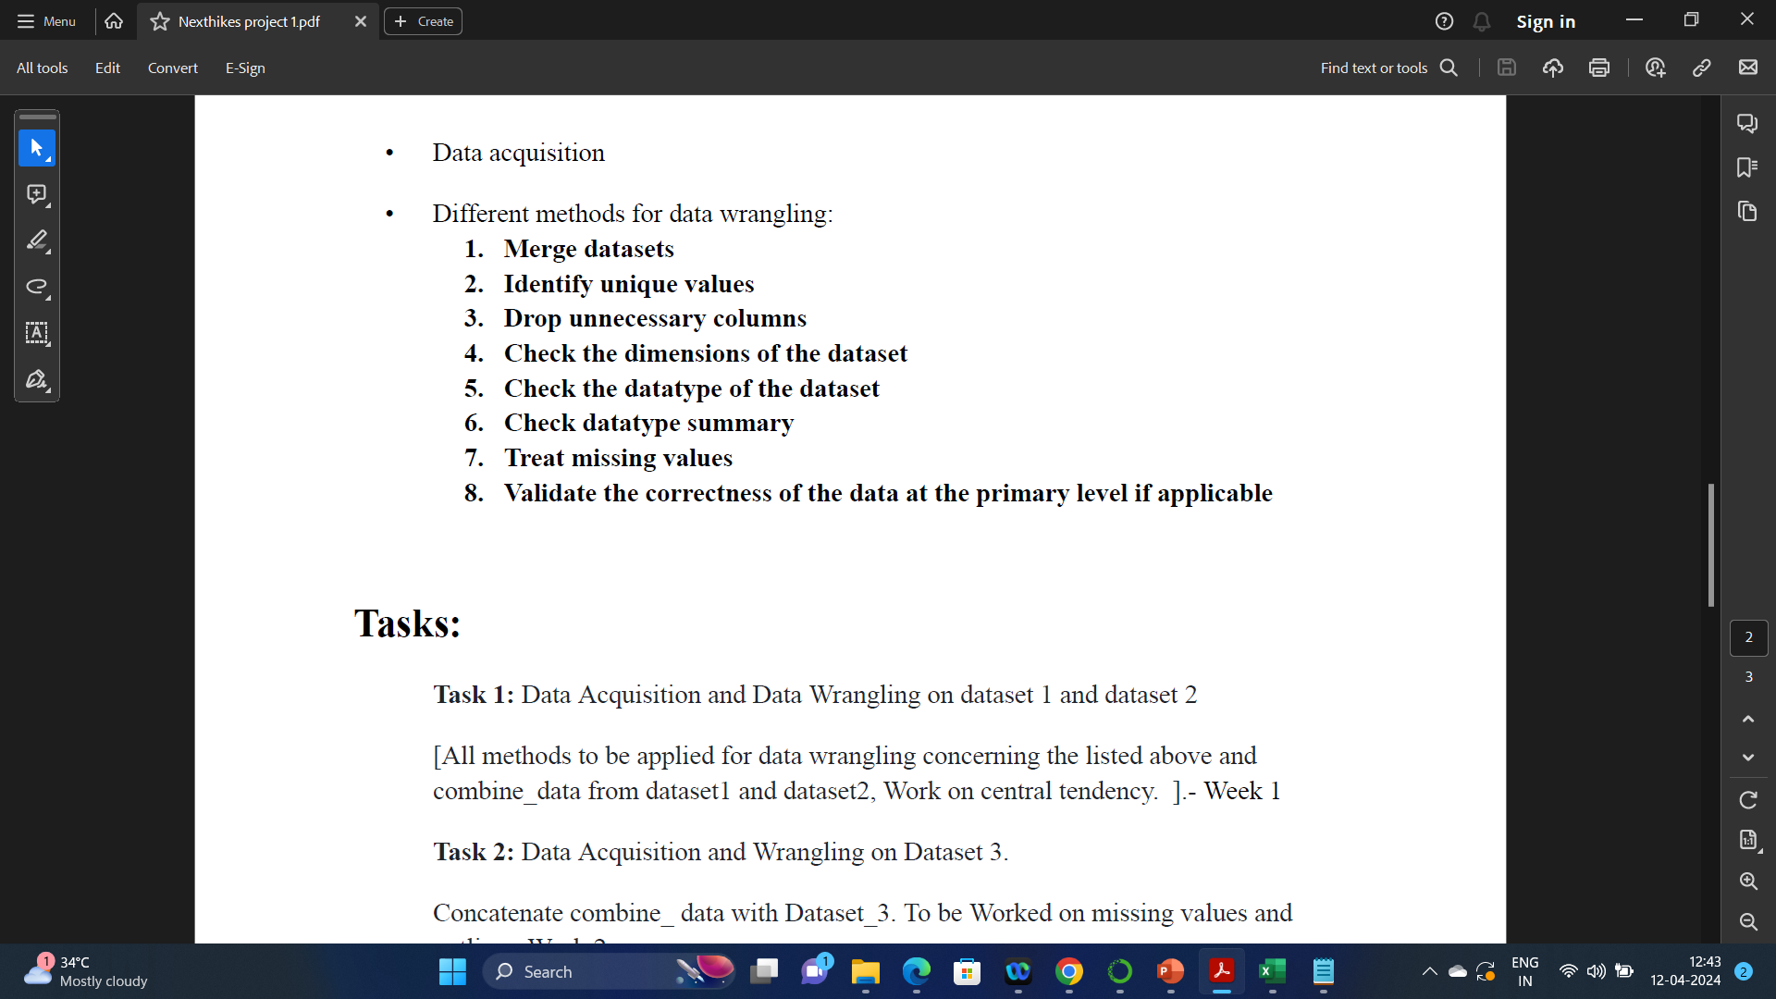
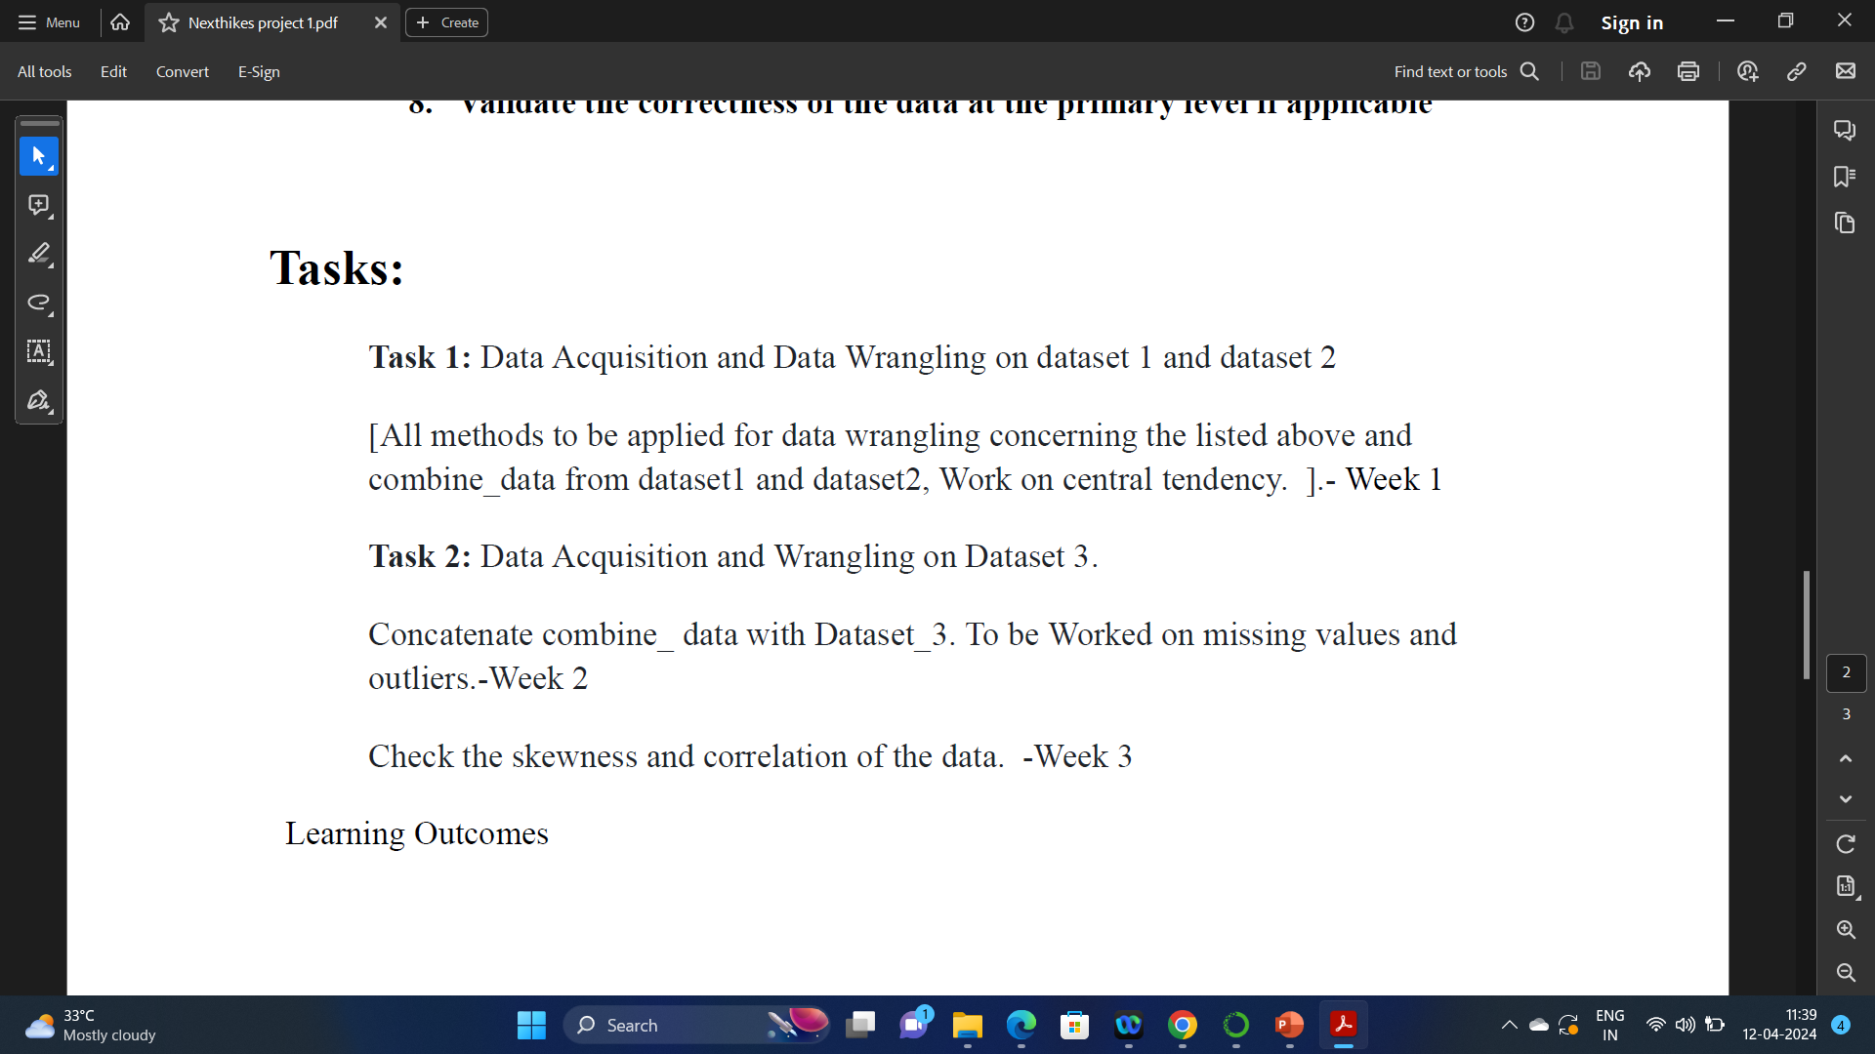
Project Tasks to be performed :

Slide 4
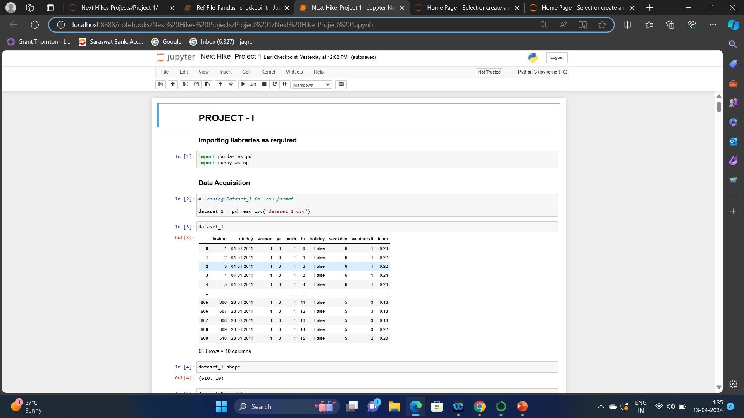
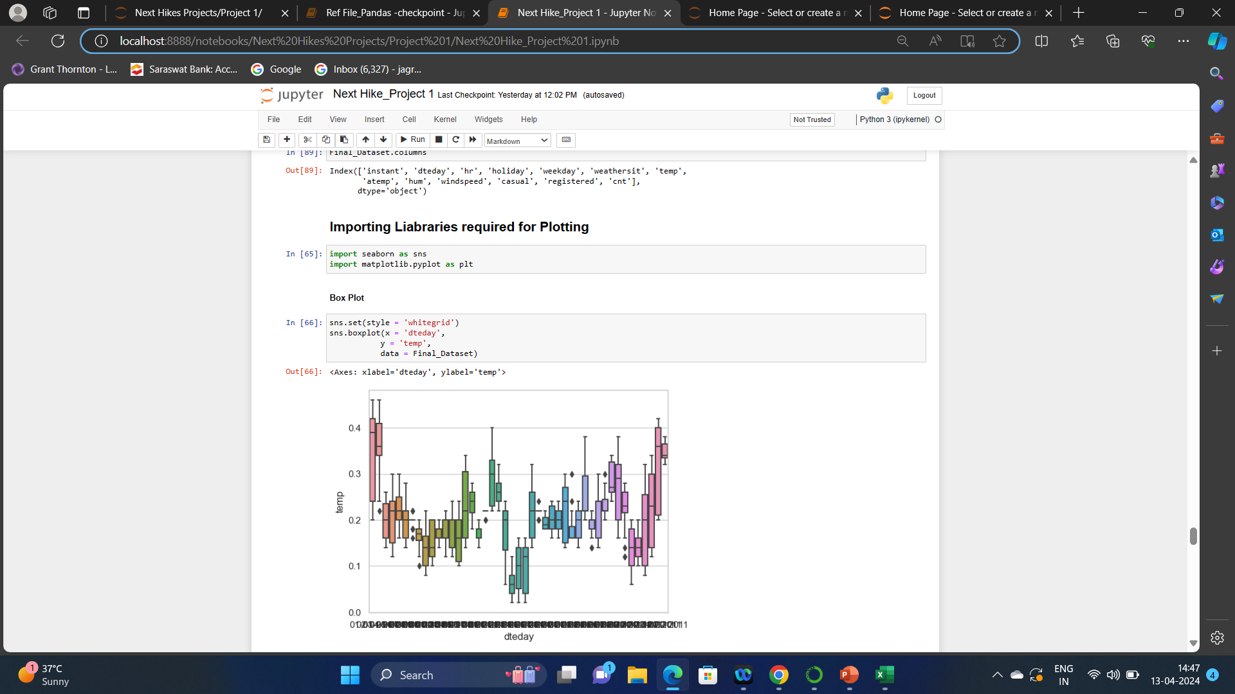
Importing Liabraries in Python: Importing libraries in Python is a way to include pre-written code into your own program. This can be useful for many things, such as performing mathematical operations, accessing data from a database, or creating graphical user interfaces. In this project, libraries that are used are described below & the screenshot from the project are attached here :
Importing ‘pandas’ as pd: This library is used for data manipulation and analysis. Pandas consist of data structures and functions to perform efficient operations on data
Importing ‘numpy’ as np : NumPy in Python is a generic-purpose package for handling arrays. It offers a multidimensional array object with outstanding capabilities as well as speed for interacting with these arrays. NumPy library in Python is open-source.
Importing ‘seaborn’ as sns : Python Seaborn library is a widely popular data visualization library that is commonly used for data science and machine learning tasks. You build it on top of the matplotlib data visualization library and can perform exploratory analysis.
Importing ‘matplotlib.pyplot’ as plt : Matplotlib is a powerful plotting library in Python used for creating static, animated, and interactive visualizations. Its primary purpose is to provide users with the tools and functionality to represent data graphically, making it easier to analyze and understand.

Slide 5
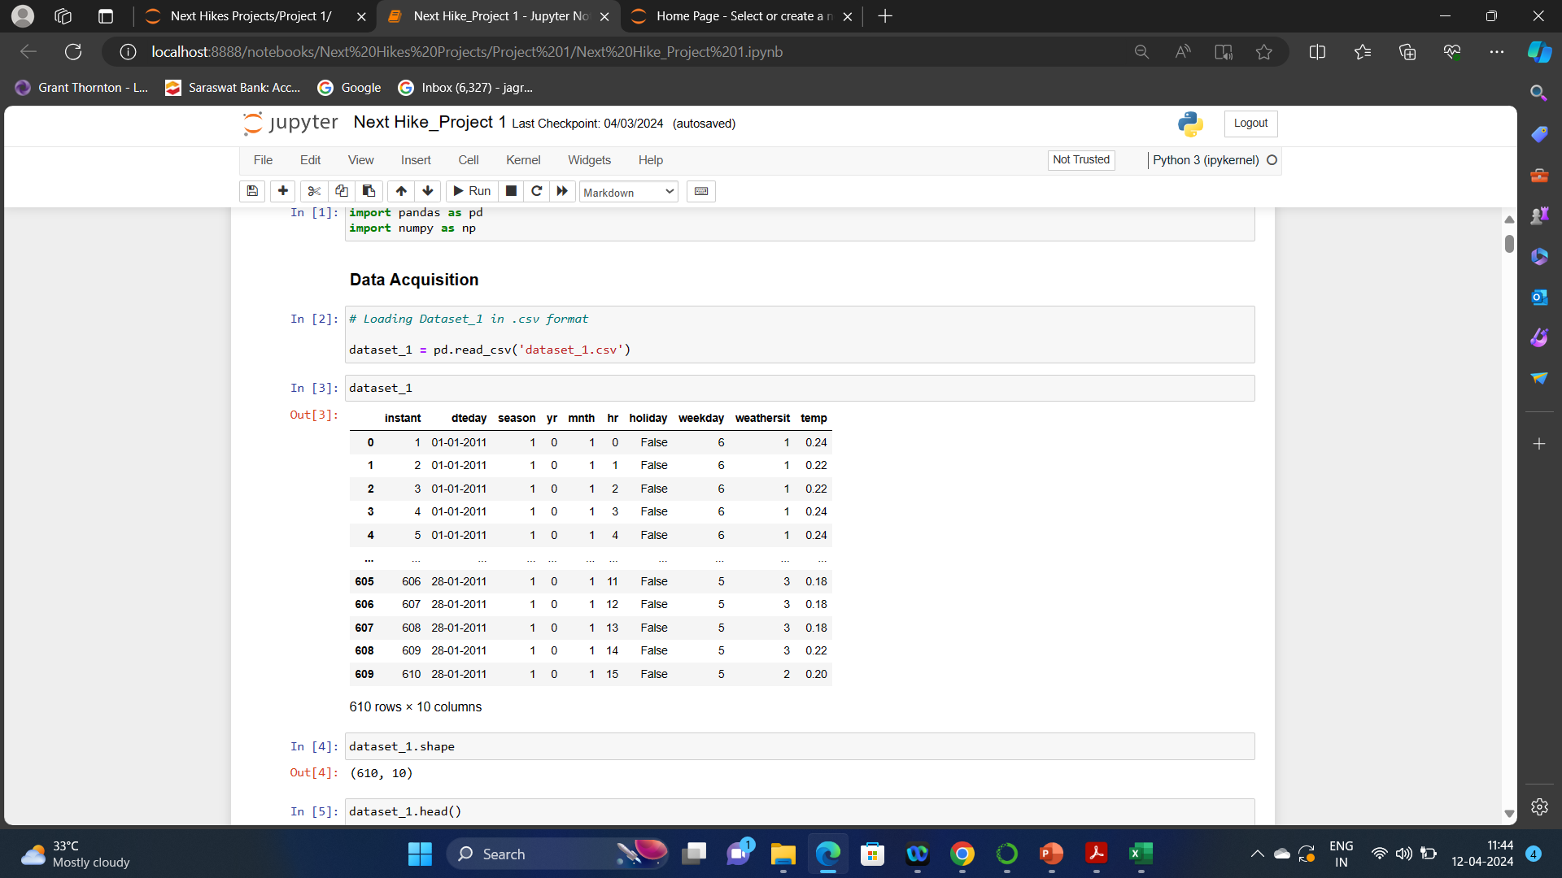
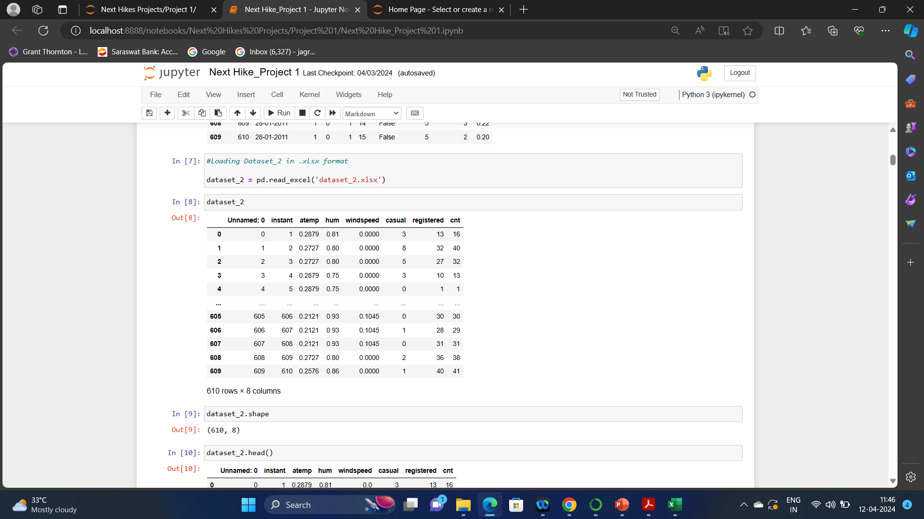
Data Acquired in Task 1 : Dataset 1(.csv format) and Dataset 2(.xlsx format). Screenshot of Dataset 1 & Dataset 2 from the project is as below:
III. Data Acquisition: Data acquisition in Python is the process of collecting data from various sources, storing it in a usable format, and analyzing it to extract useful information. All the data to be acquired in python is related to ‘Bicycle Riding’.

Slide 6
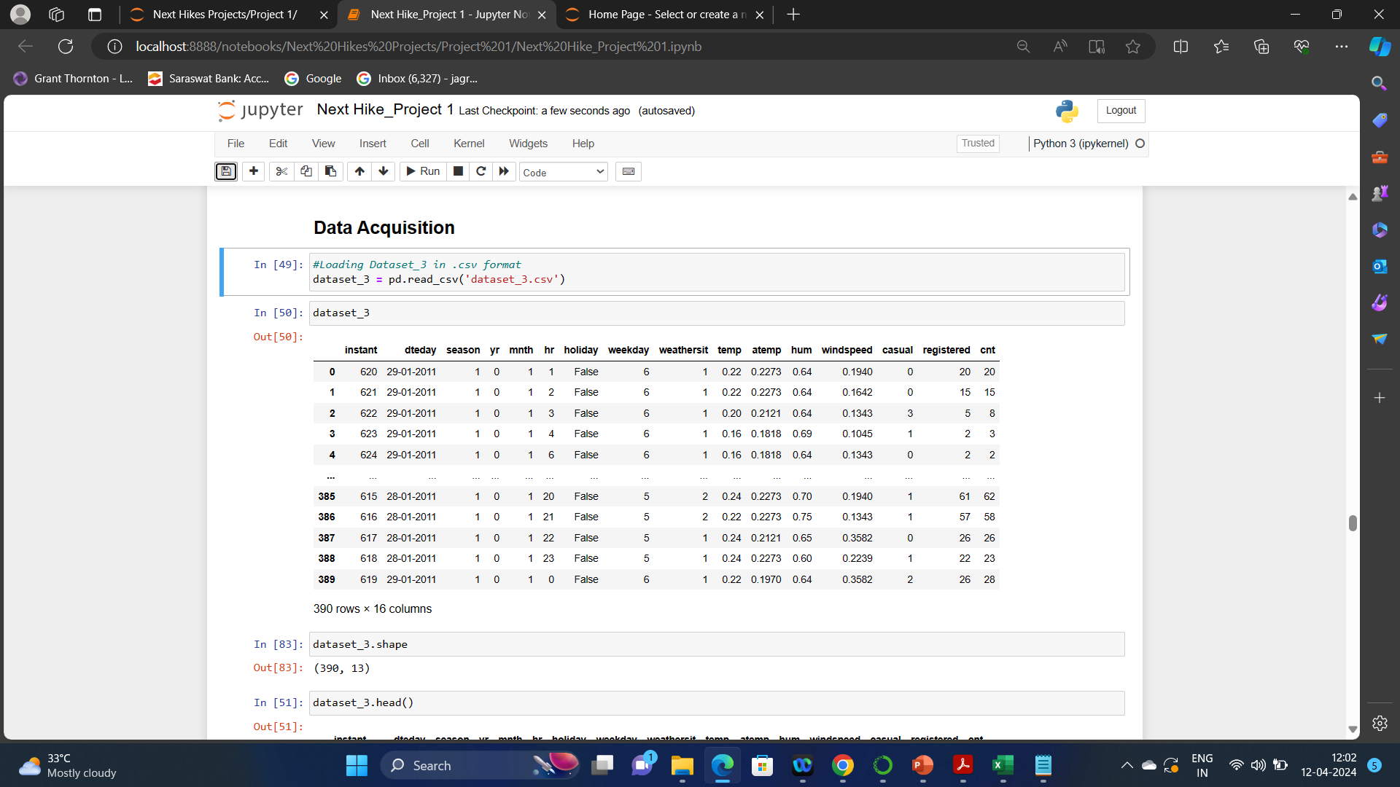
Data Acquired in Task 2 : Dataset 3(.csv format). Screenshot of Dataset 3 is as below:

Slide 7
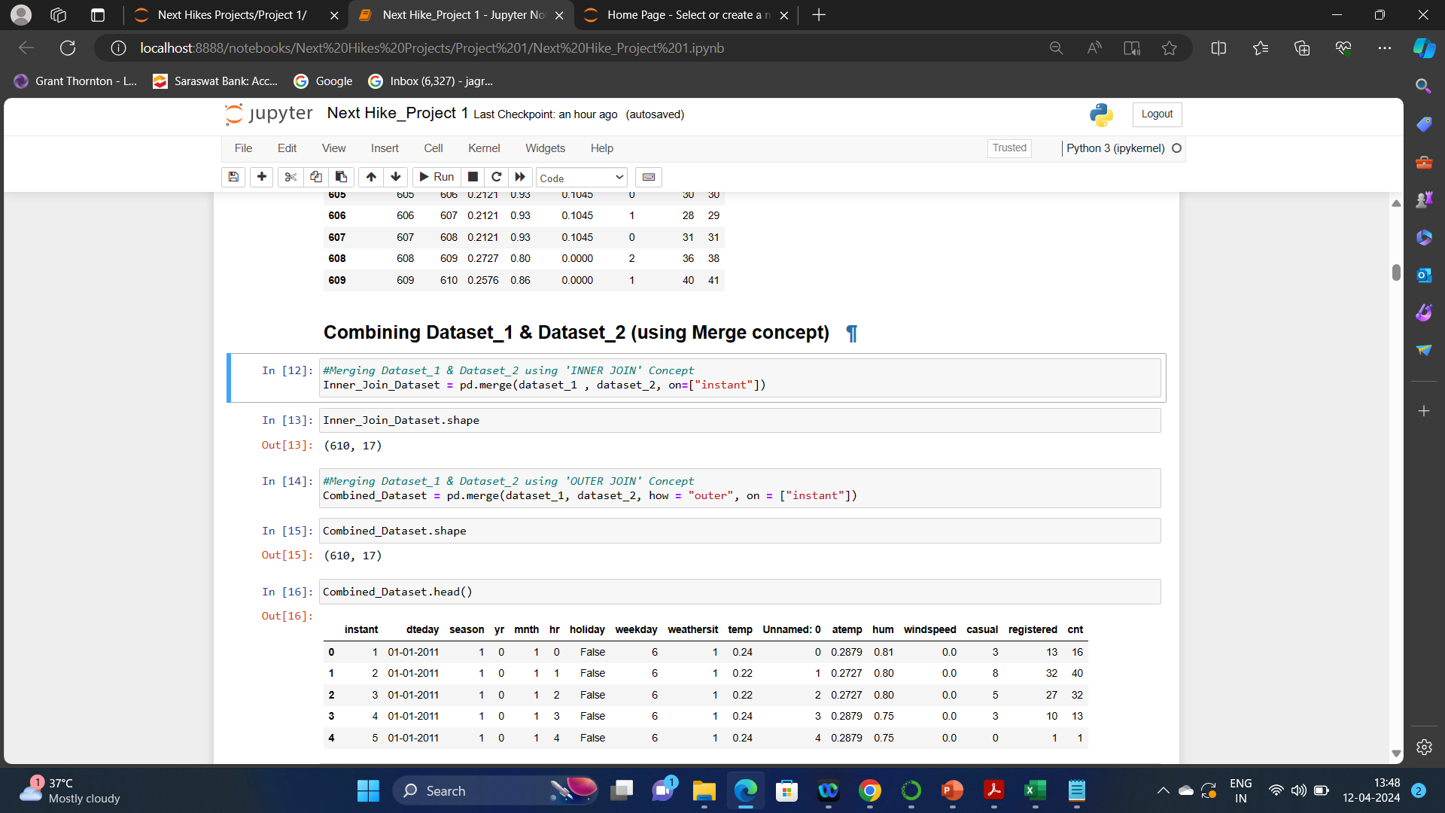
Data Wrangling: It is the process of gathering, collecting, and transforming Raw data into another format for better understanding, decision-making, accessing, and analysis in less time. Data Wrangling is also known as Data Munging. Different methods that are performed in the project is discussed below:
1. Merge Datasets: It is the process of combining two or more datasets into a single one. This can be done using the pandas library, which provides a number of functions for data manipulation and analysis. There are 3 main methods through datasets can be combined - .merge( ), .join( ) & .concat( ).
Combining of Dataset 1 & Dataset 2 in Task 1: (through .merge() concept)

Slide 8
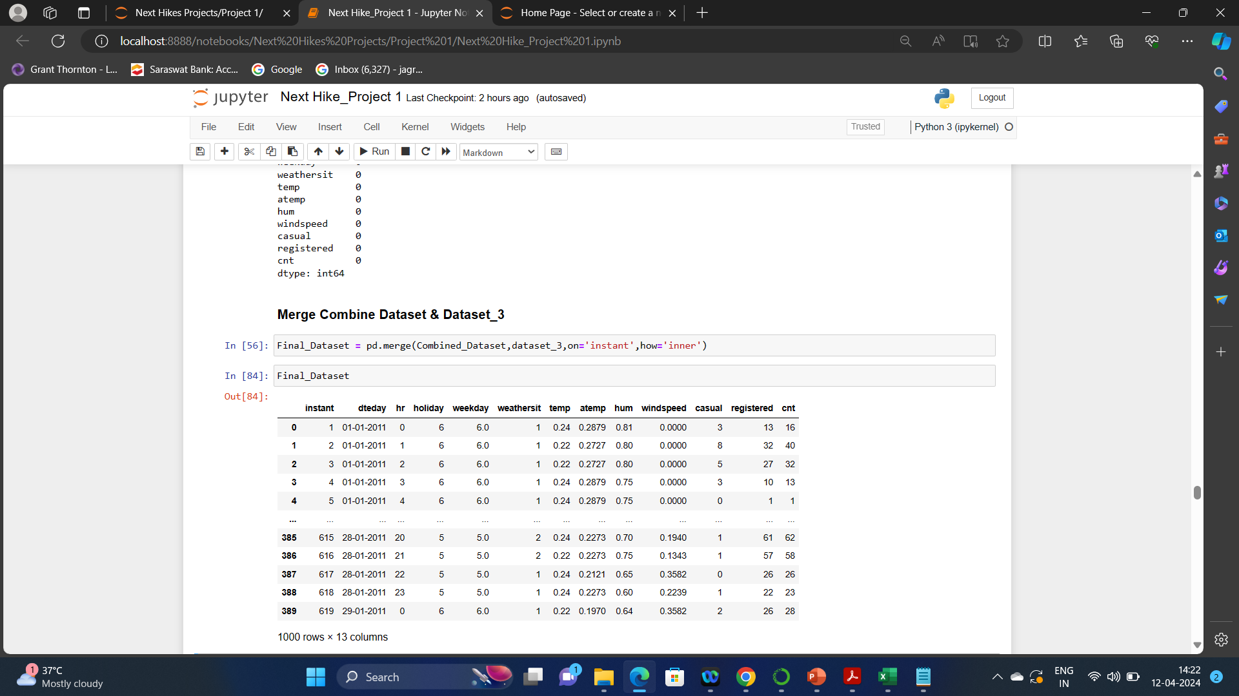
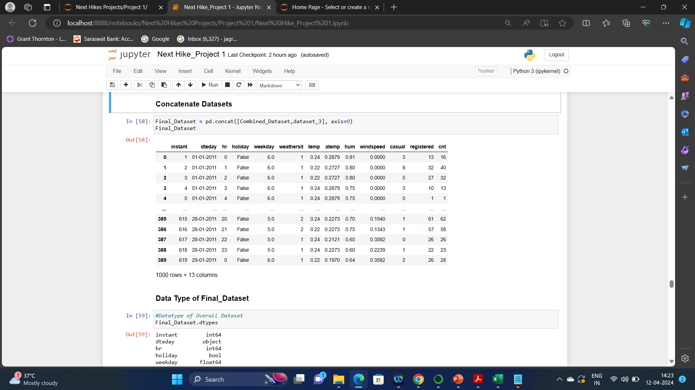
Combining of ‘Combined_Dataset (merged dataset 1 & dataset 2 in task 1) & Dataset 3: (through .merge() & .concat() concept)

Slide 9
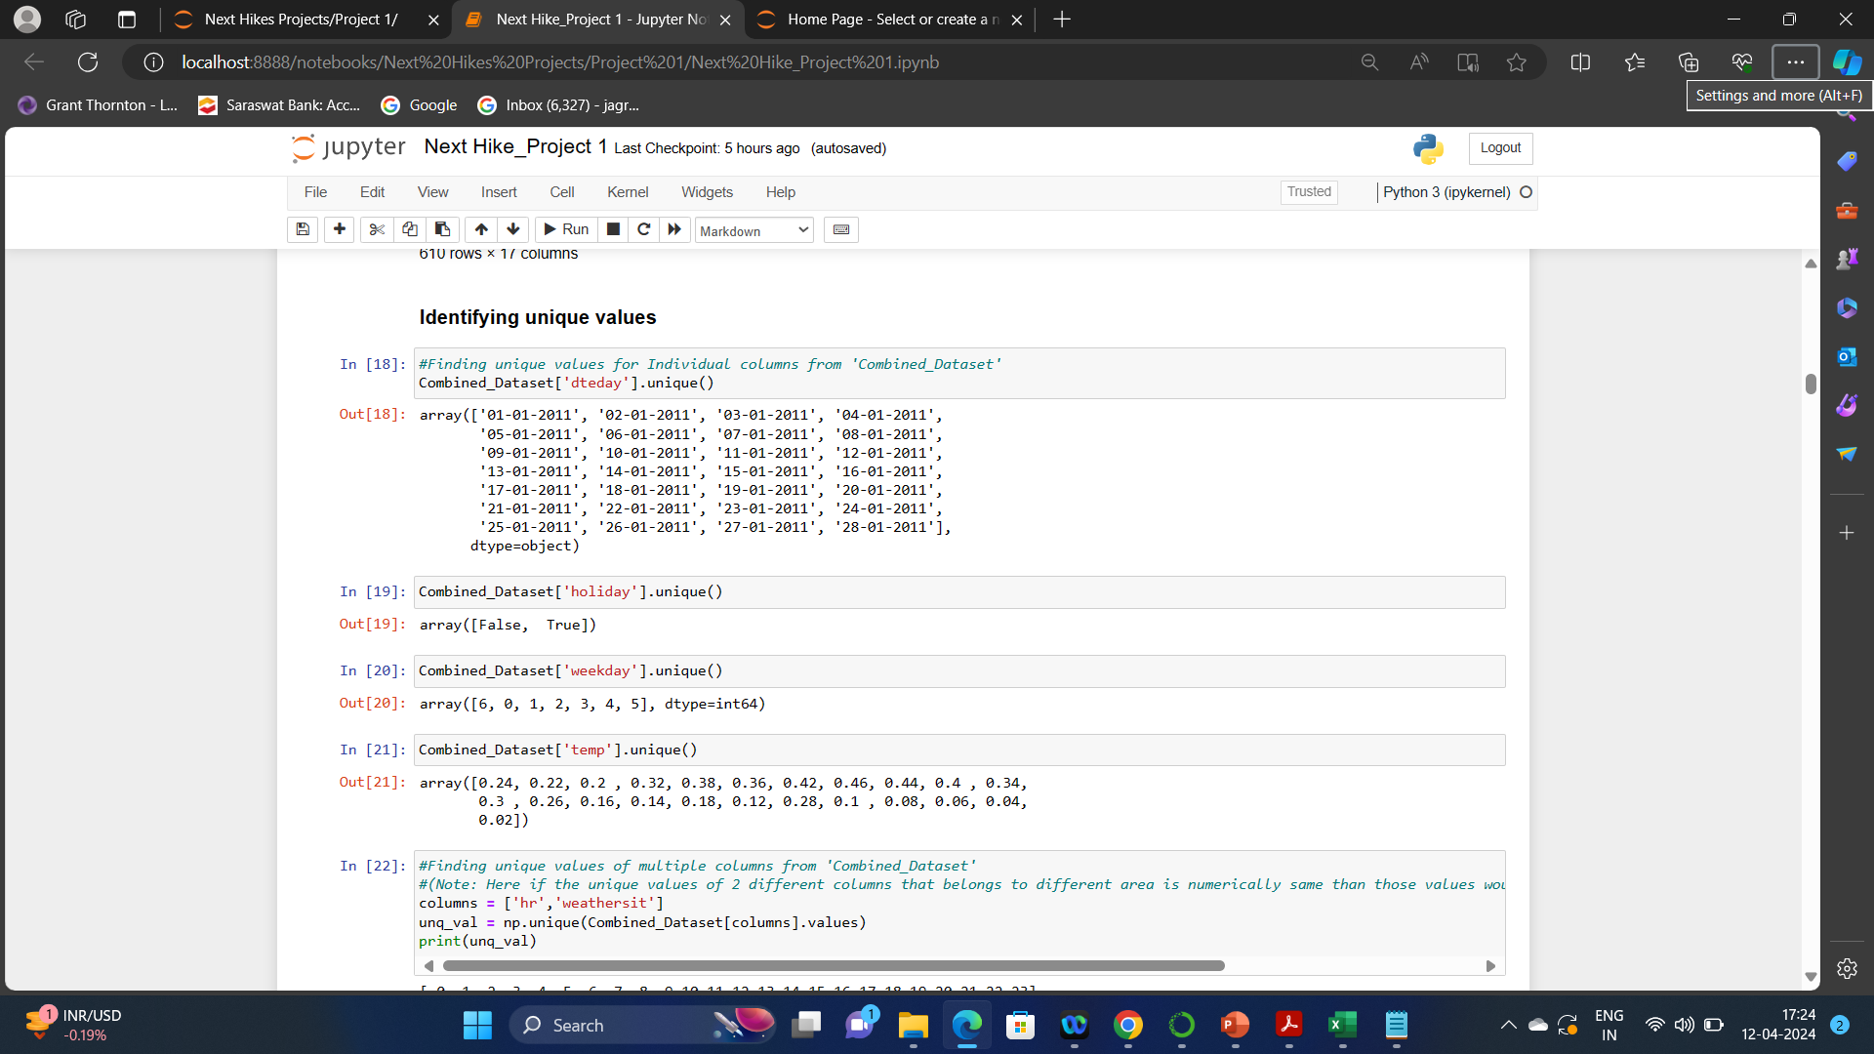
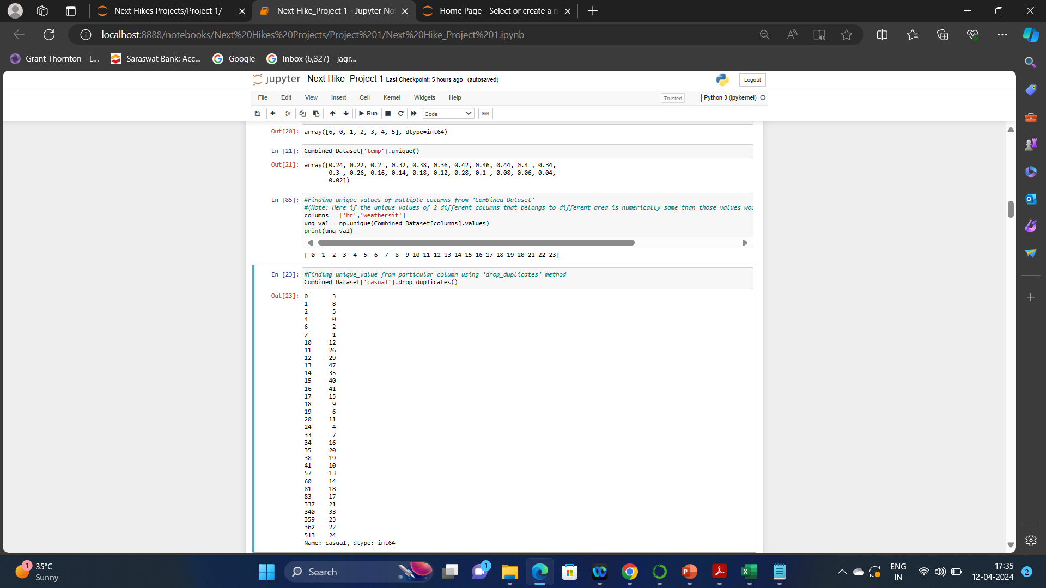
Identifying Unique Values: Identifying unique values in Python is the process of finding the elements in the dataset, in a list or array that only appear once.
Identified columnwise unique values using .unique() method
Identified unique value multiple columnwise using .unique() method

Slide 10
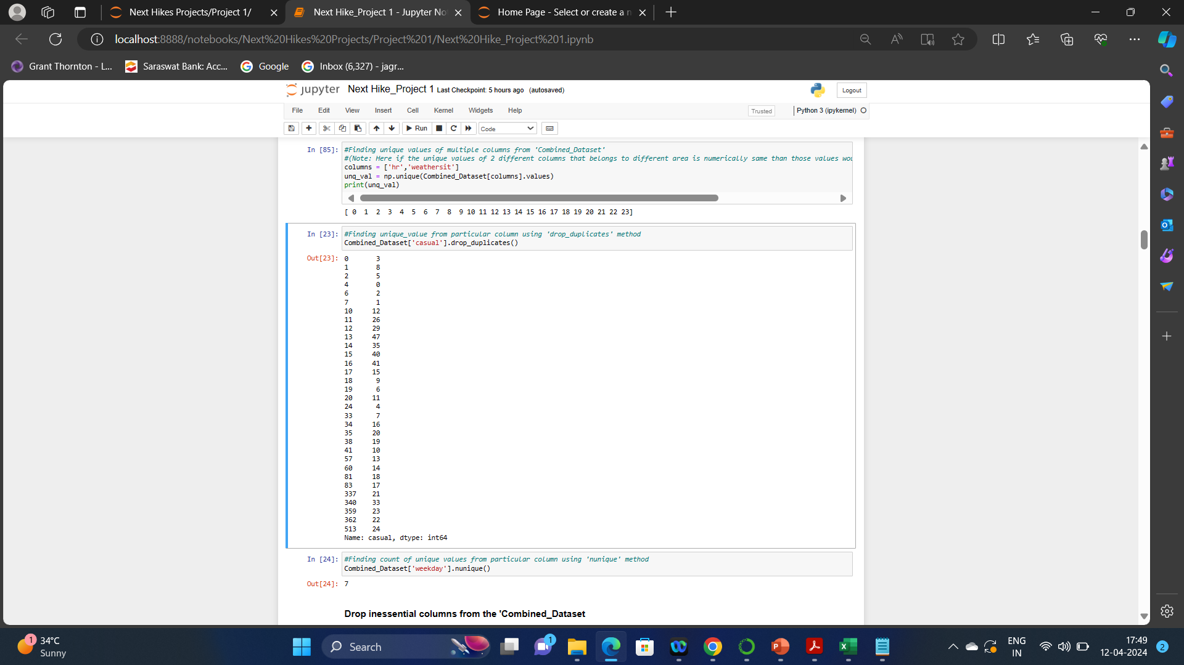
Identified column wise unique values using drop_duplicates method and .nunique() method

Slide 11
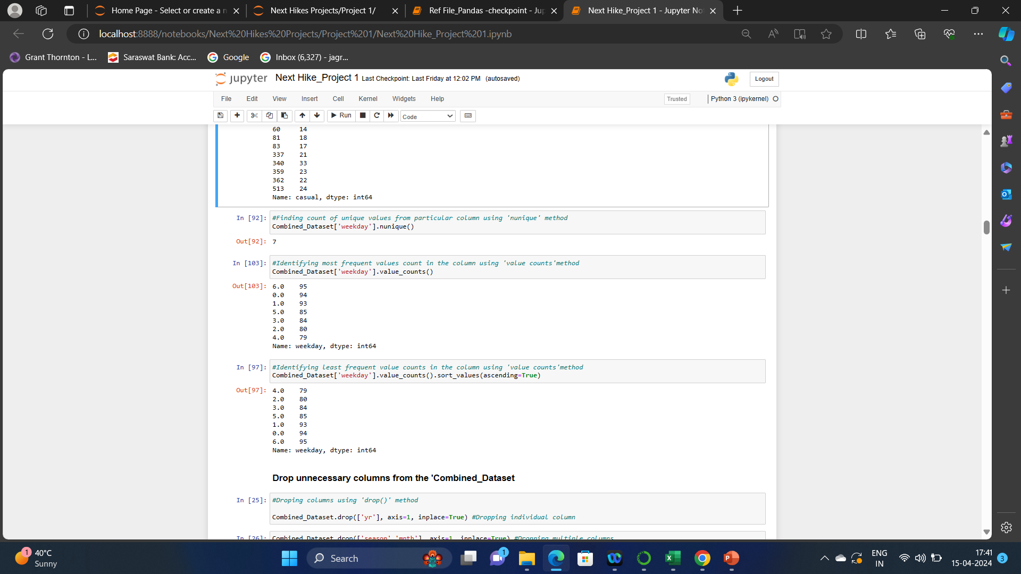

Identified most frequent values counts in the column using Value_counts method
Identified least frequent values counts in the column using Value_counts method

Slide 12
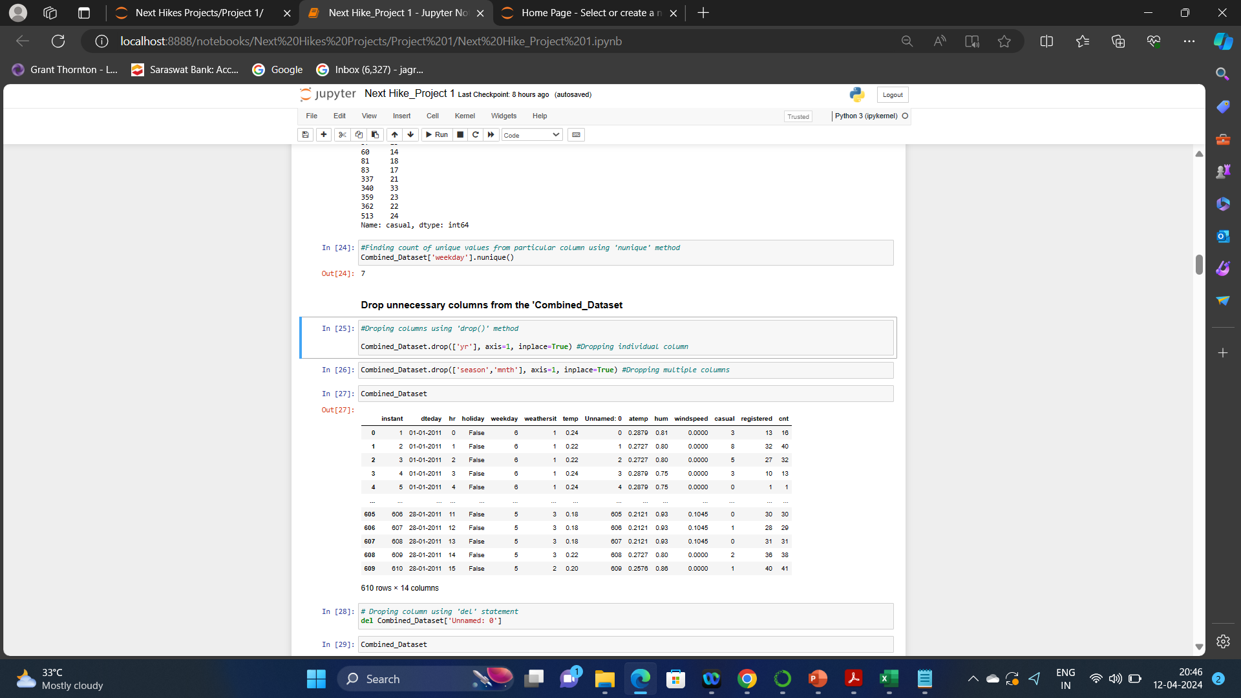
Drop unnecessary columns: Drop one or multiple columns in pandas with the methods such as: ‘.drop()’method, ‘iloc[]’ method, ‘.ix()’ method, ‘.loc[]’ method, Iterative method ,‘.pop()’ method & del statement. Few methods are used in project as below:
Dropping Individual column & multiple columns using .drop() method

Slide 13
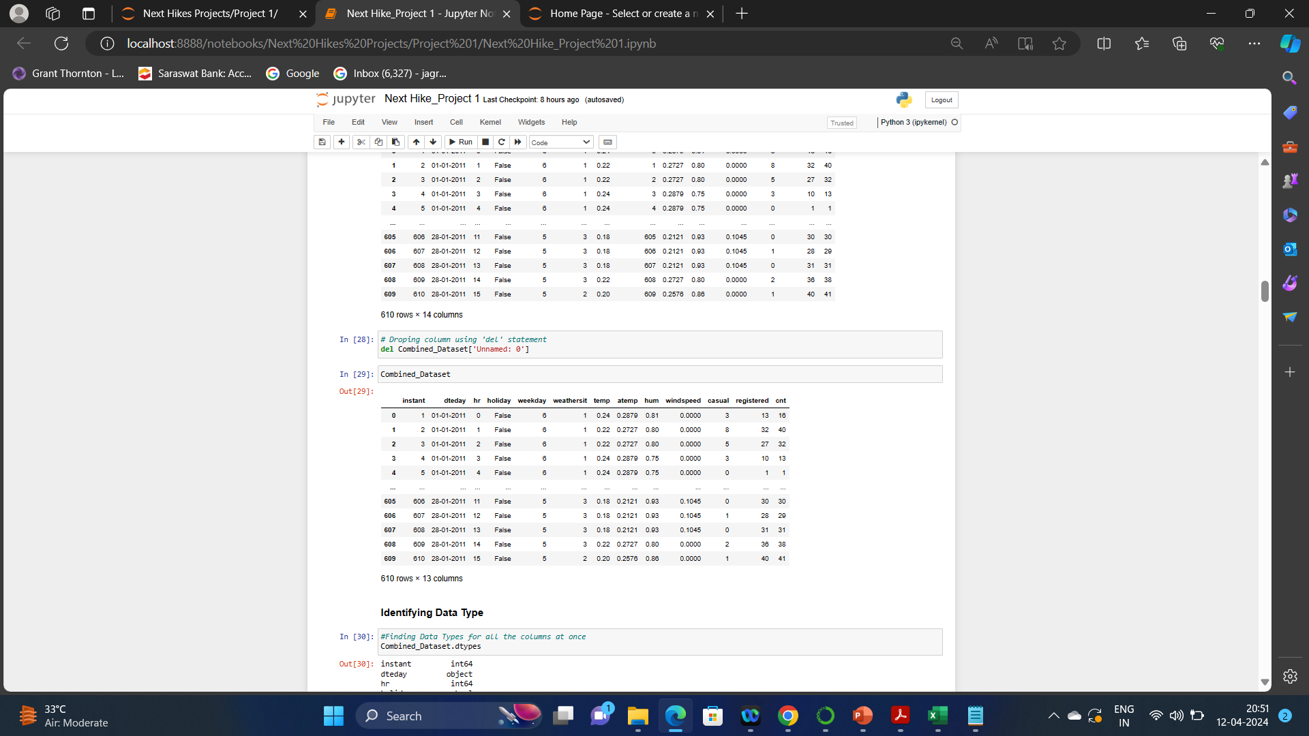
Dropping column using del statement

Slide 14
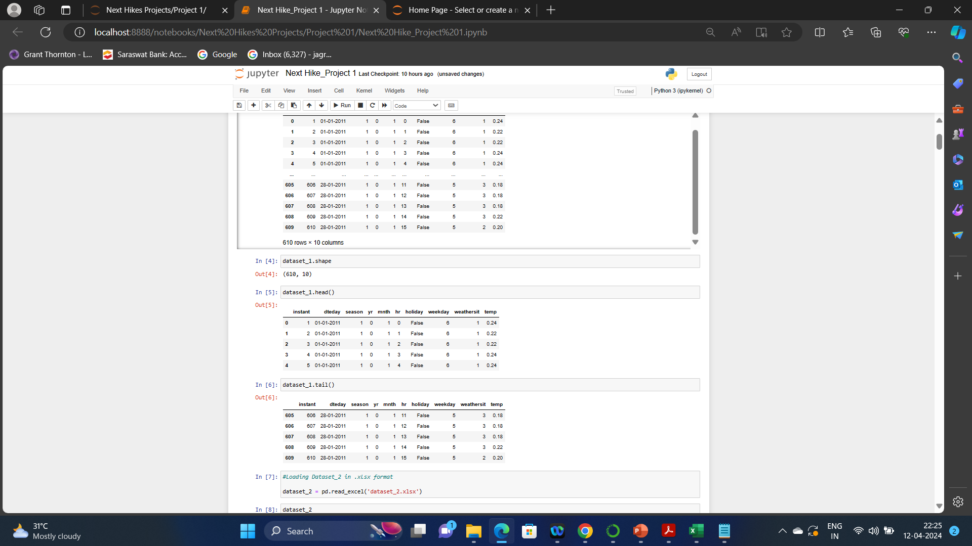
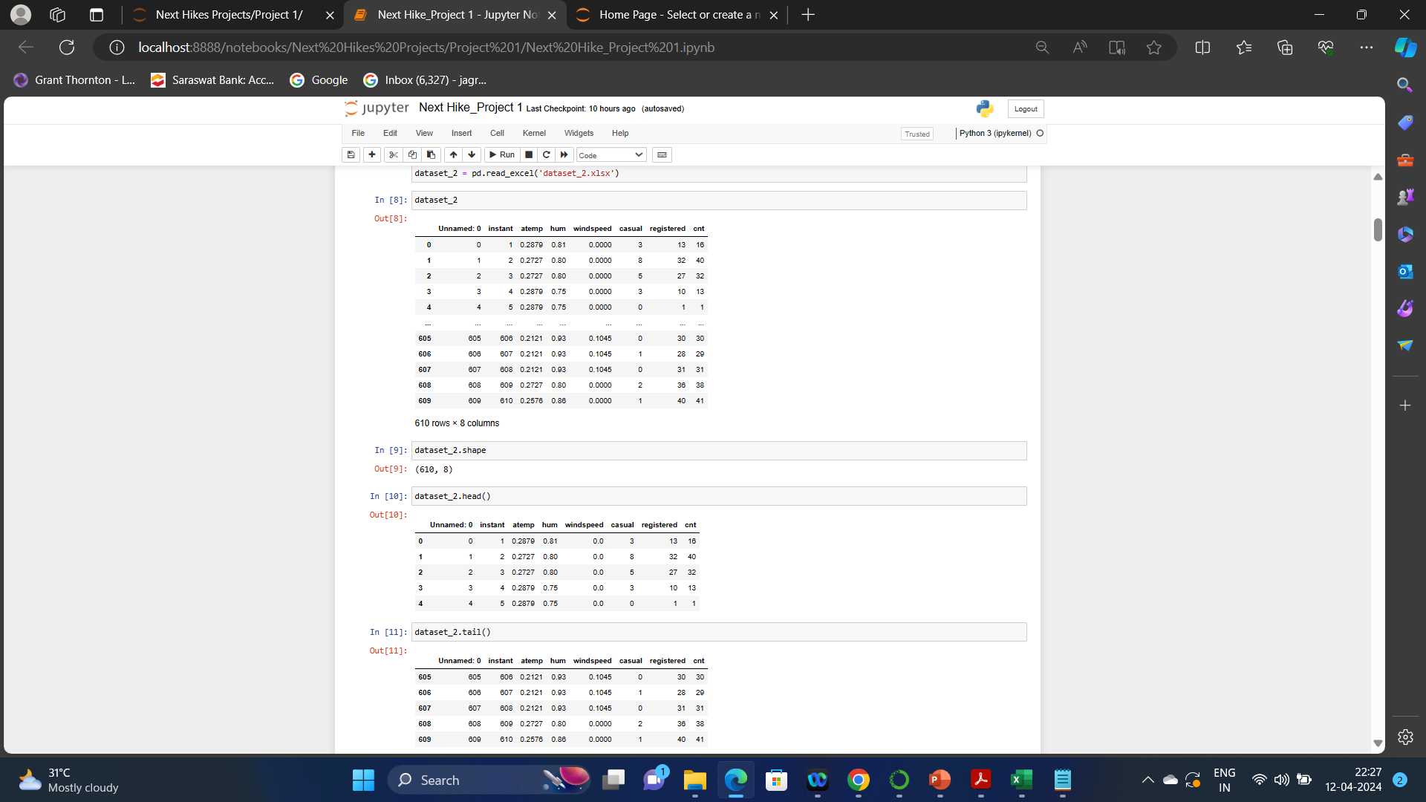
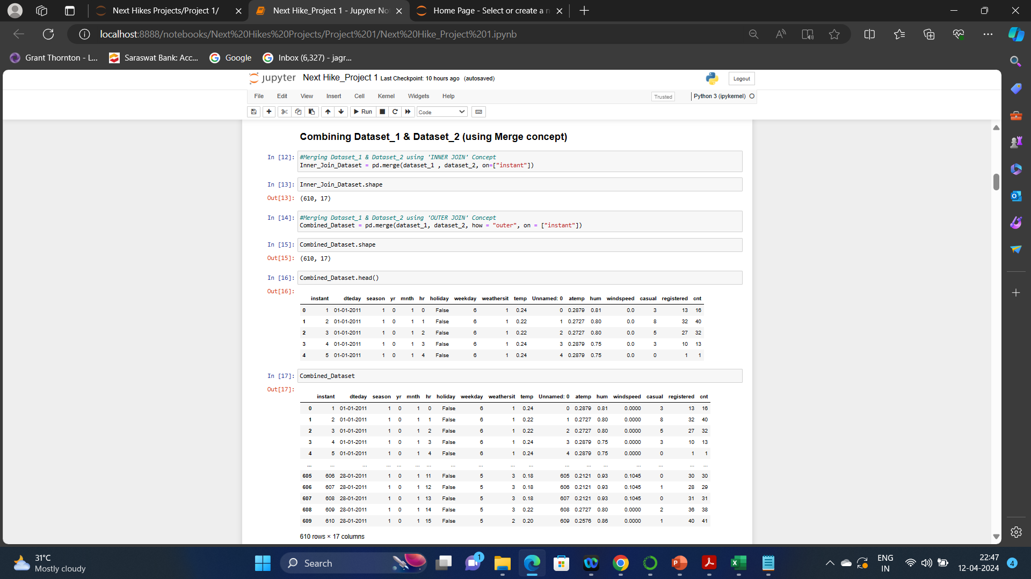
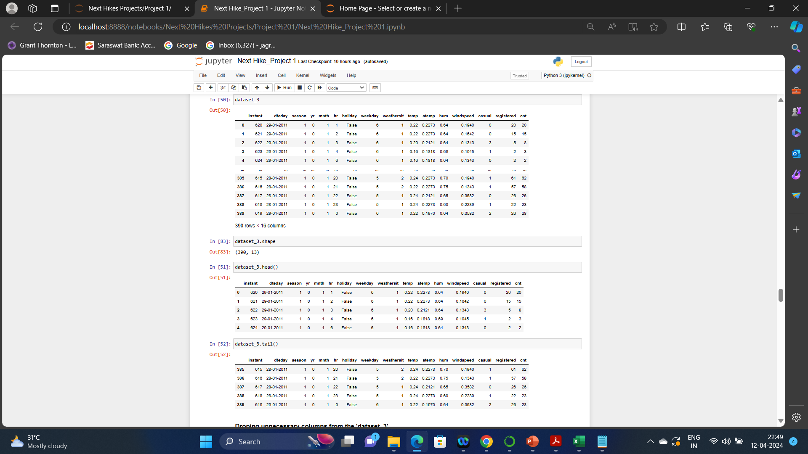
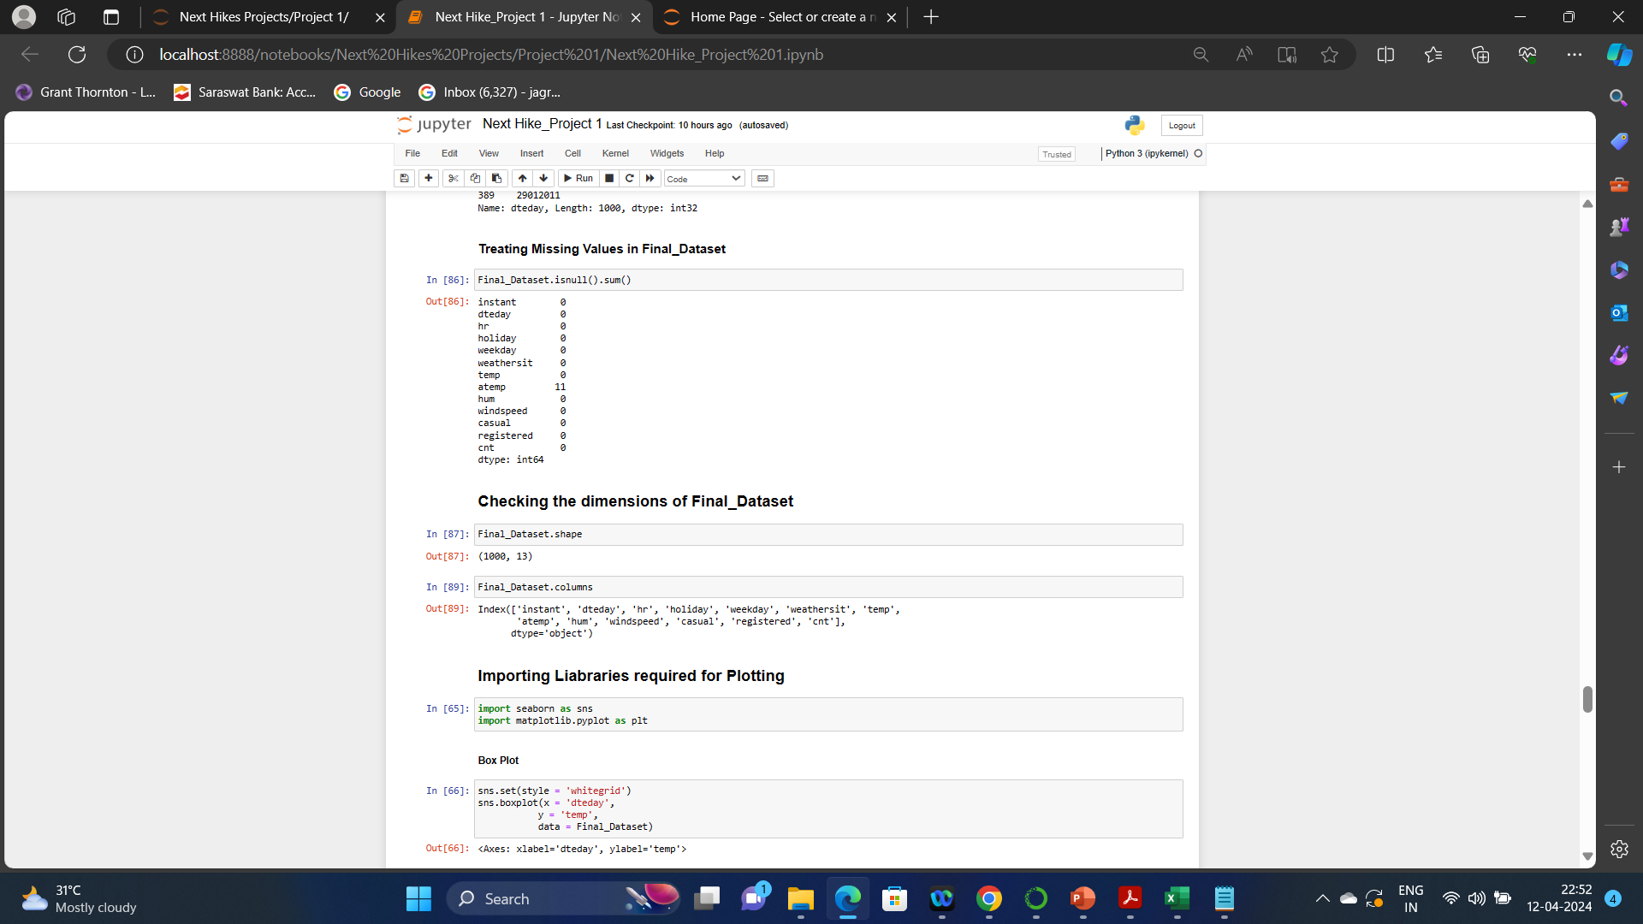
Check the dimensions of the datasets: Checking dimensions in Python refers to determining the number of axes or subscripts required to specify an individual element of an array. Checking dimensions in project through .shape() method

Slide 15
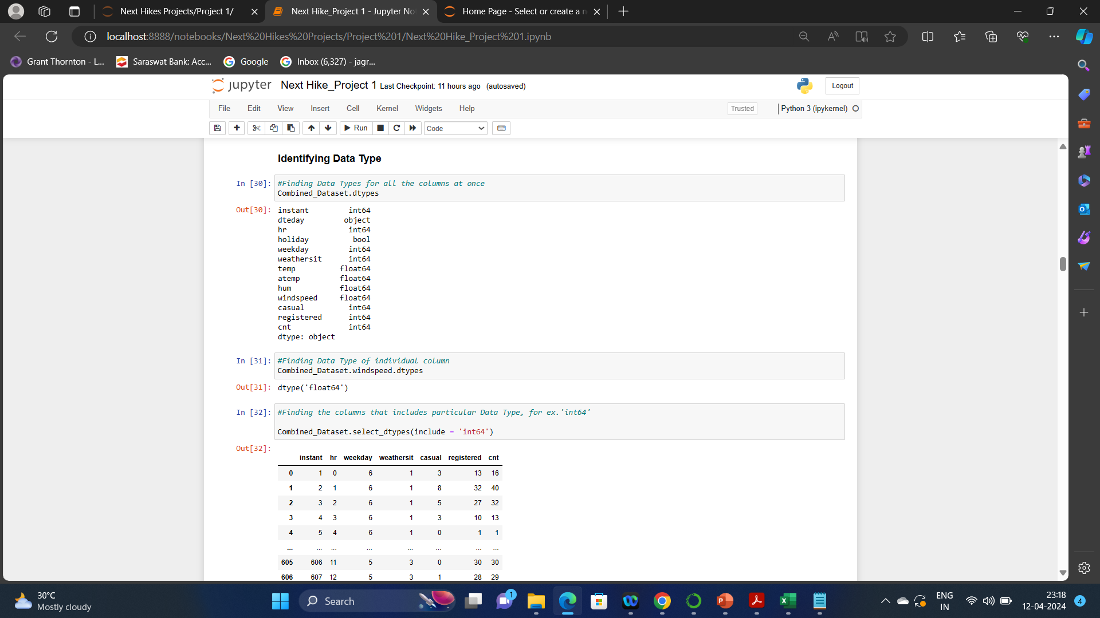
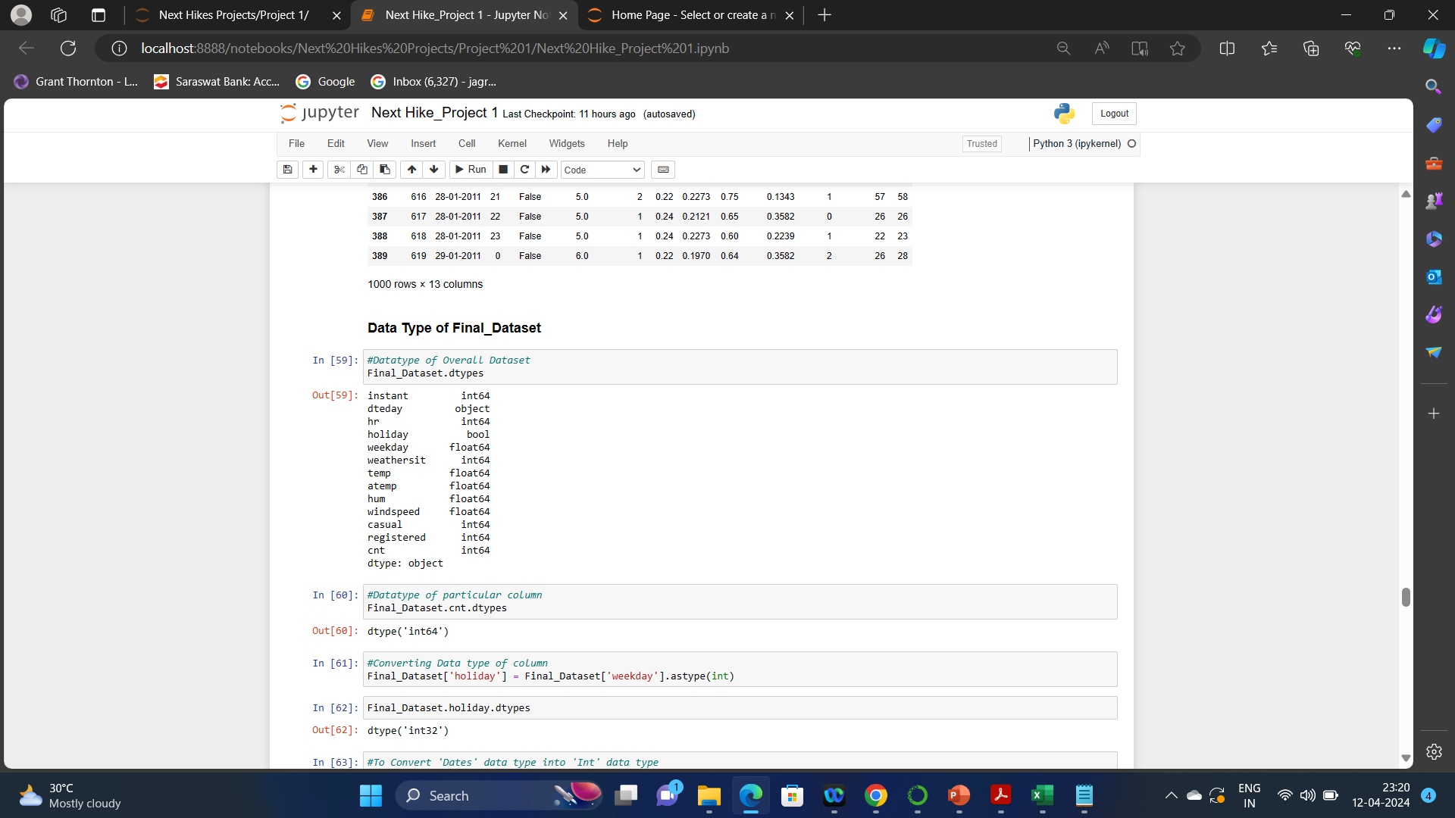
Check data types of the datasets: In Python, there are several built-in data types that can be used to store and manipulate data. Datatypes of datasets in Python refers to the types of data that are stored in a data sets.
Finding of data type of overall dataset as well as of individual column as shown in below screenshots from Task 1 & Task 2

Slide 16
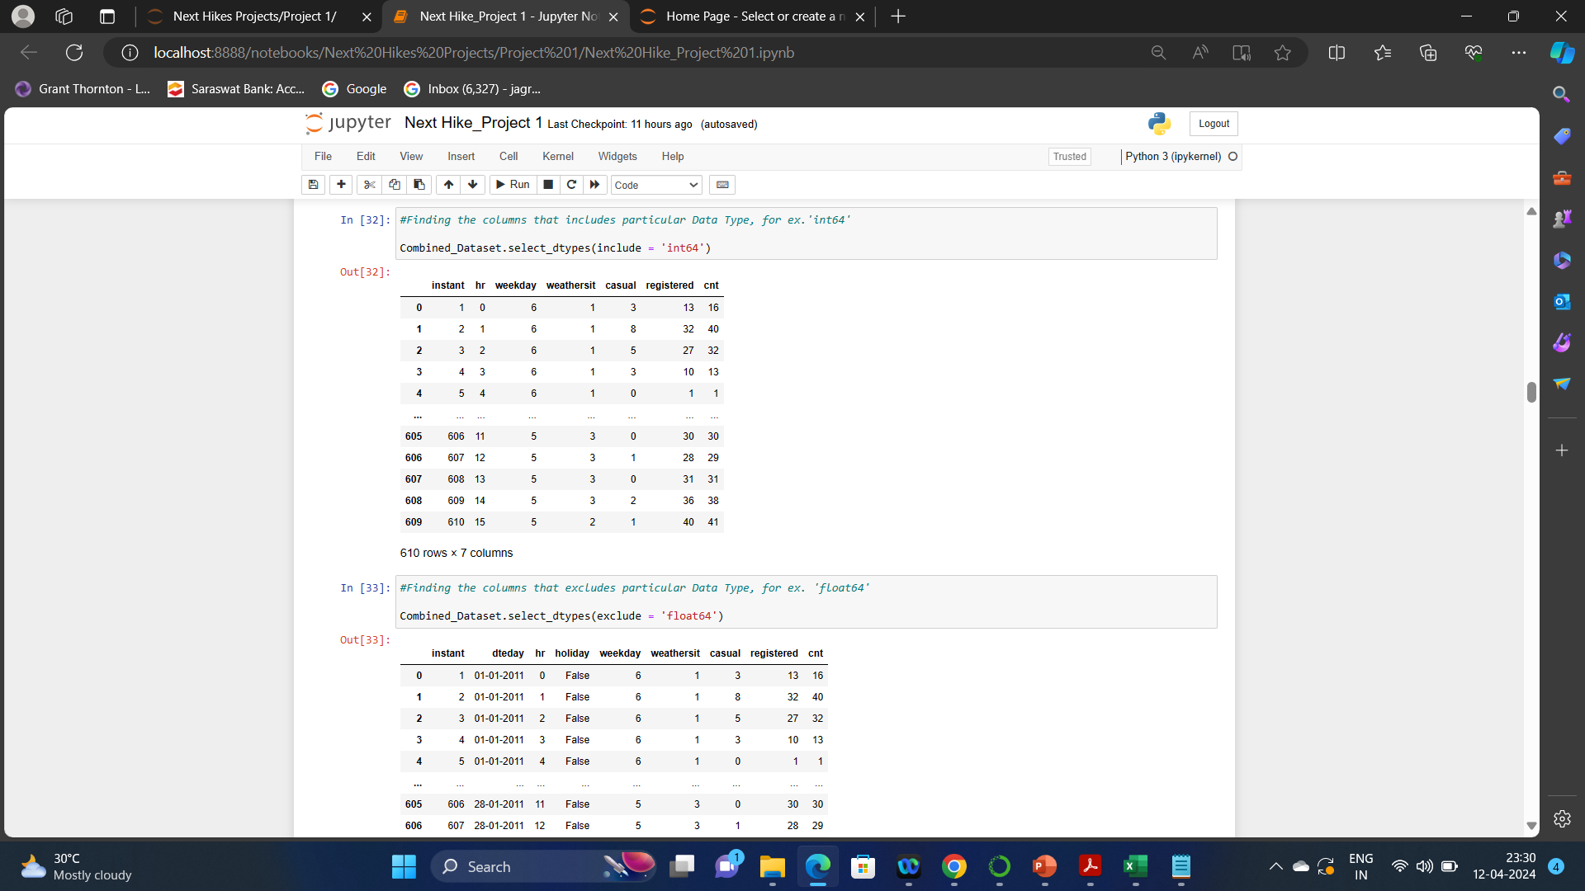
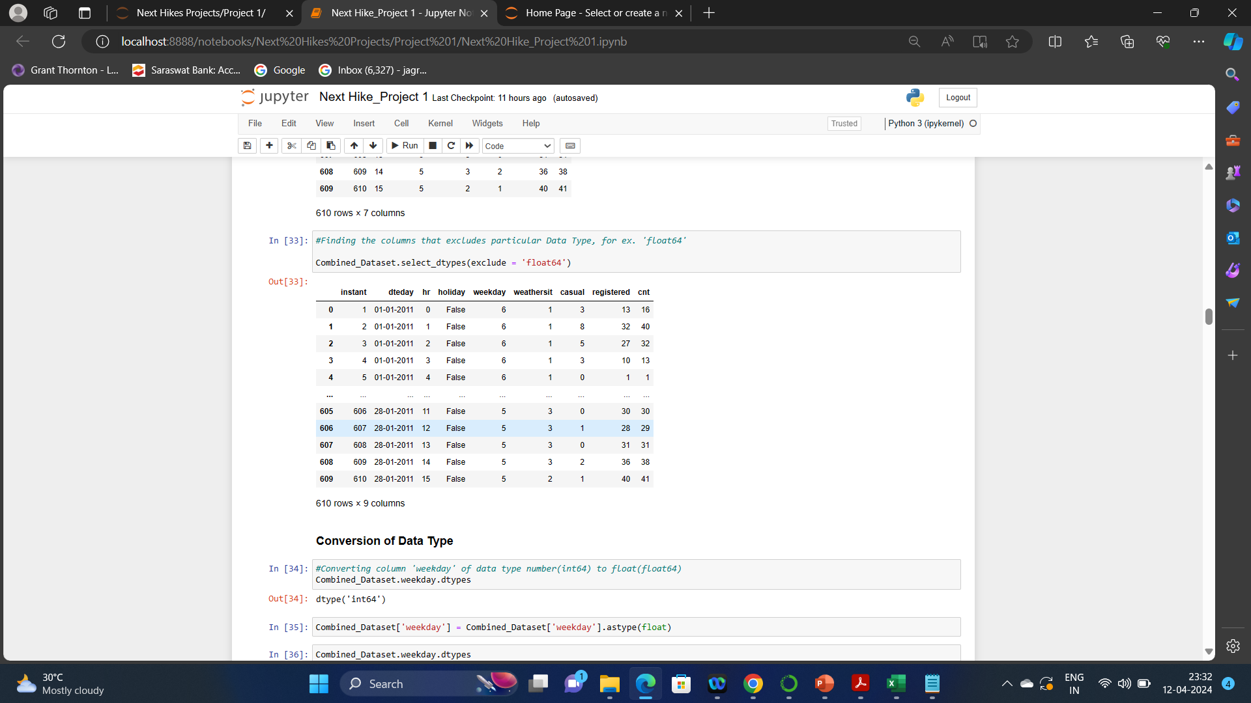
Finding of data type by including or excluding data type as shown in below screenshots from Task 1

Slide 17
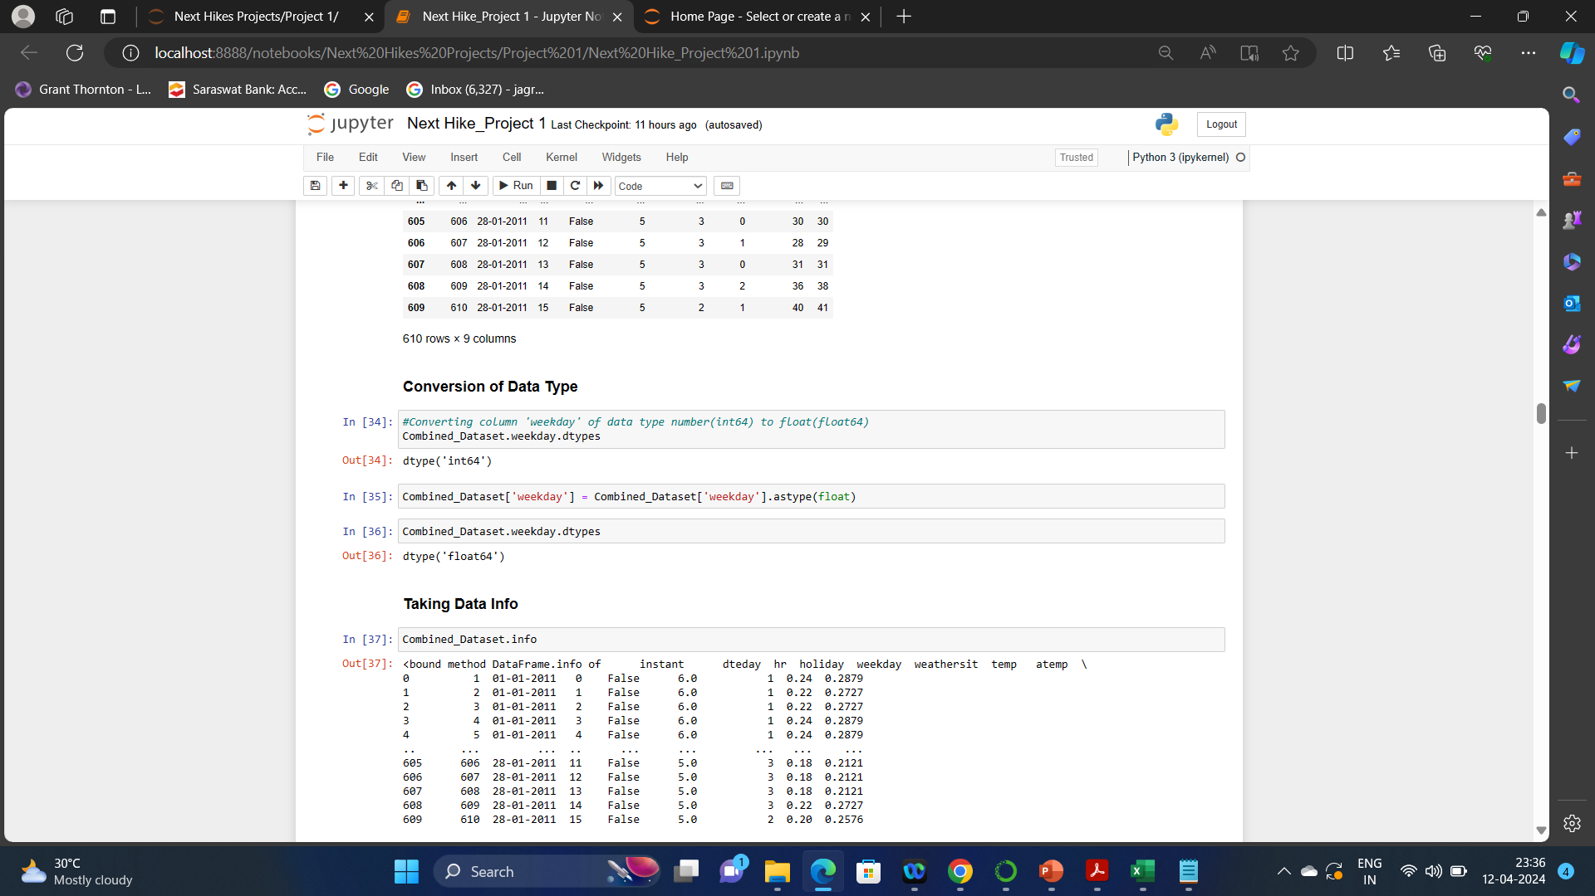
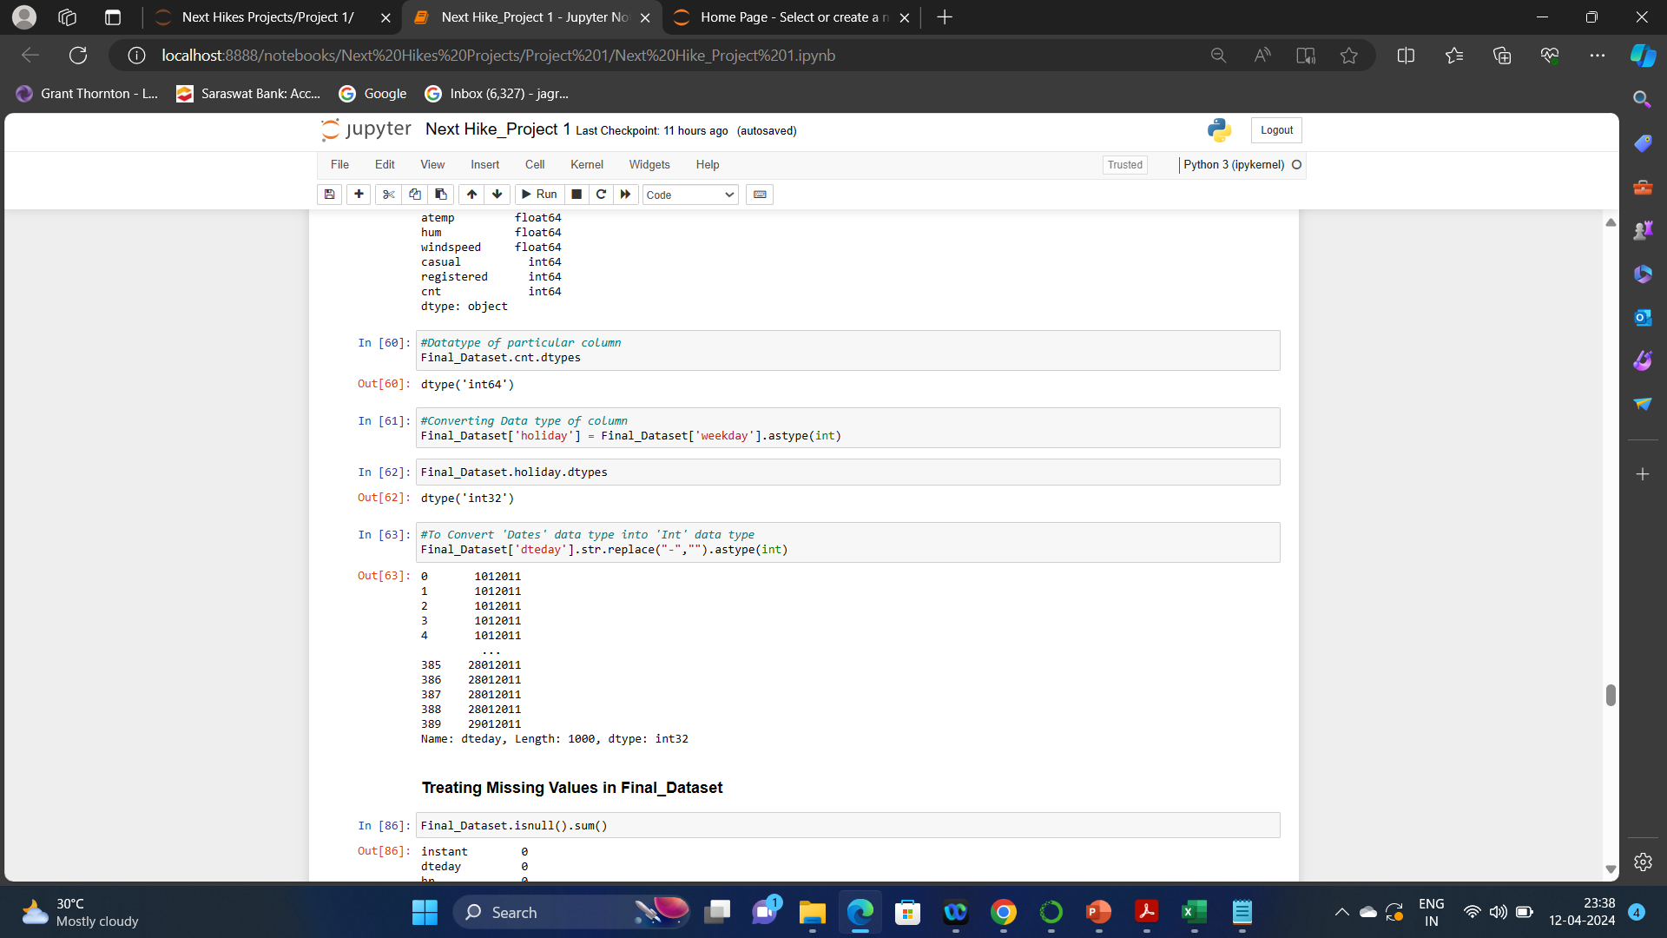
Conversion of data types as shown in below screenshots from Task 1 & Task 2
Task 1 :
Task 2 :

Slide 18
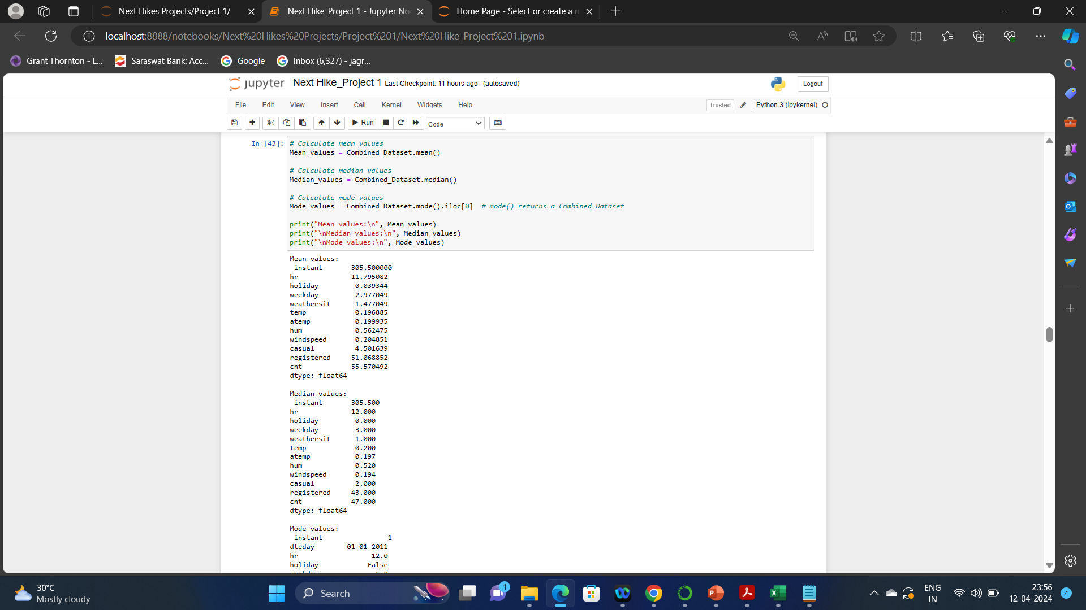
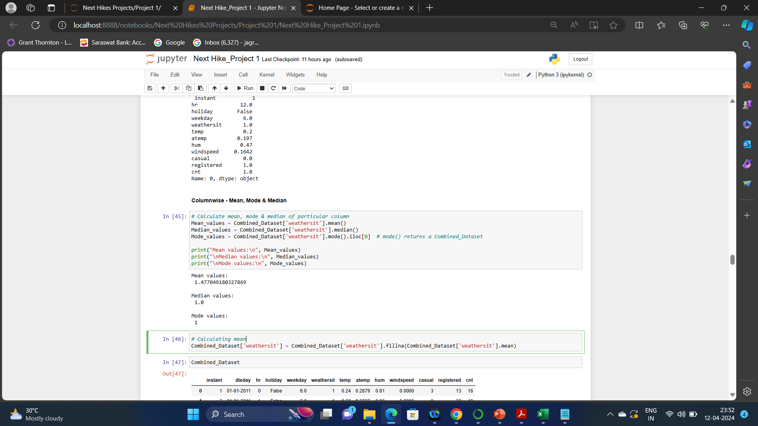
Working on Central Tendency: Central tendency is defined as “the statistical measure that identifies a single value as representative of an entire distribution”. It aims to provide an accurate description of the entire data. It is the single value that is most typical/representative of the collected data. Central tendency - Mean, Mode & Median.
Screenshots below are of calculated central tendency from Task 1:

Slide 19
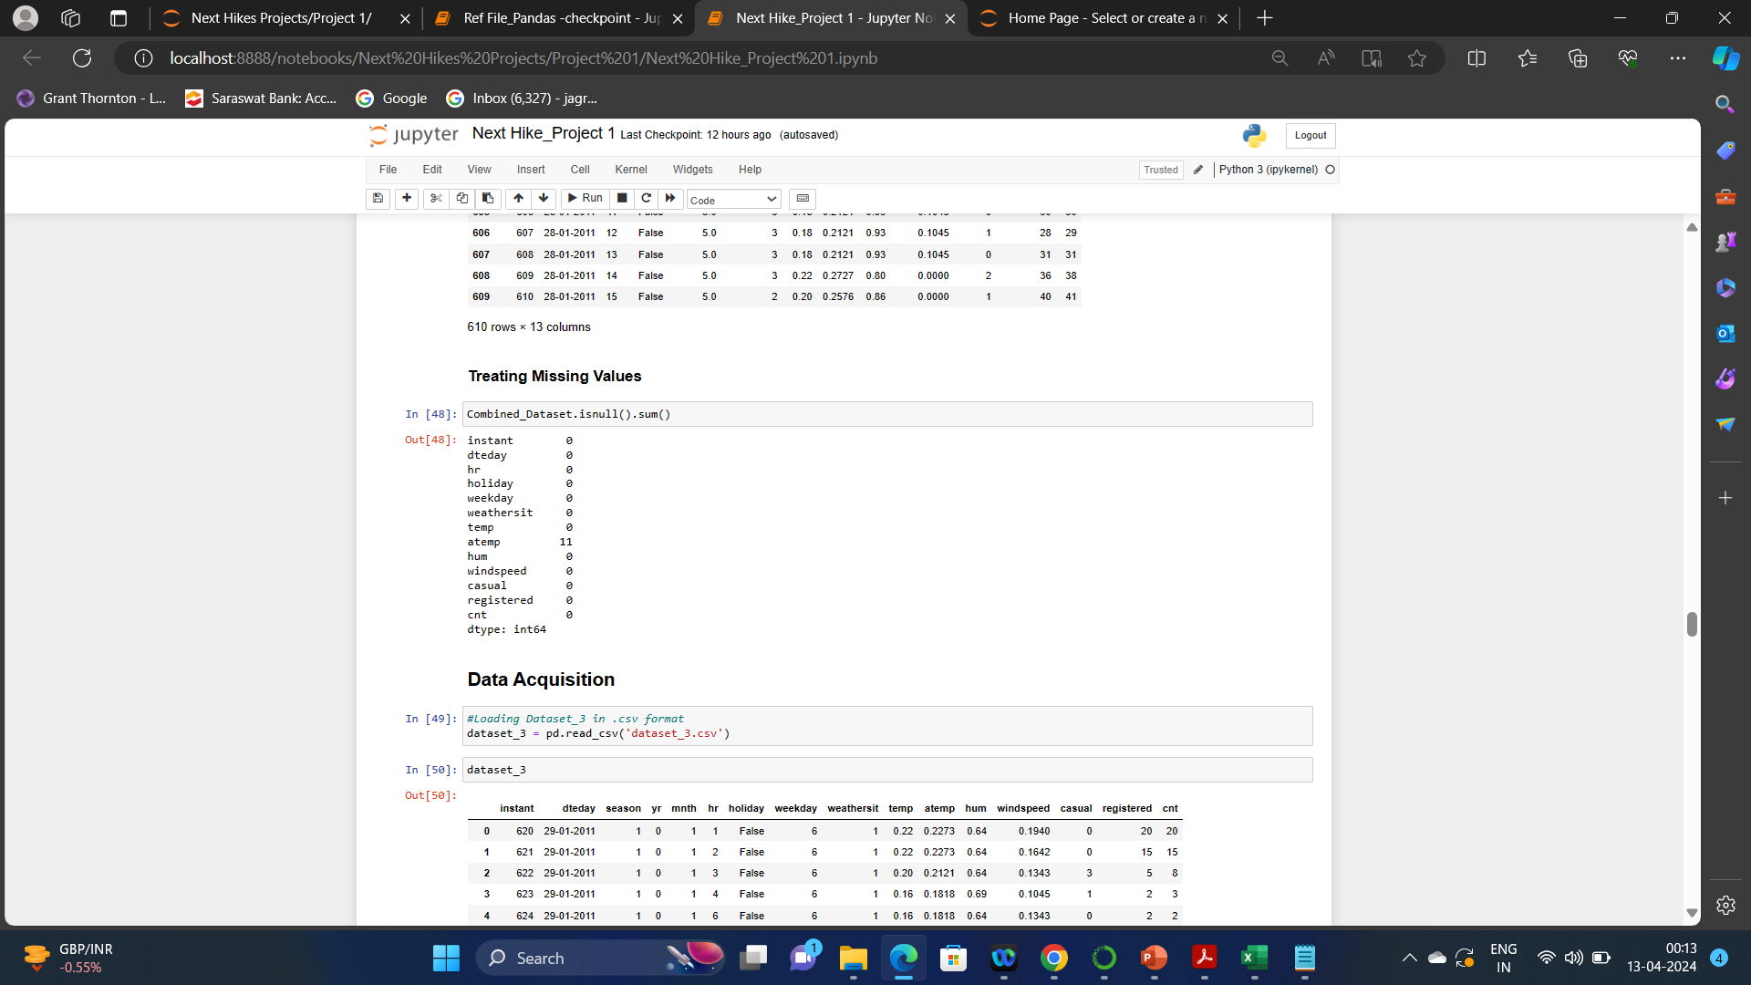
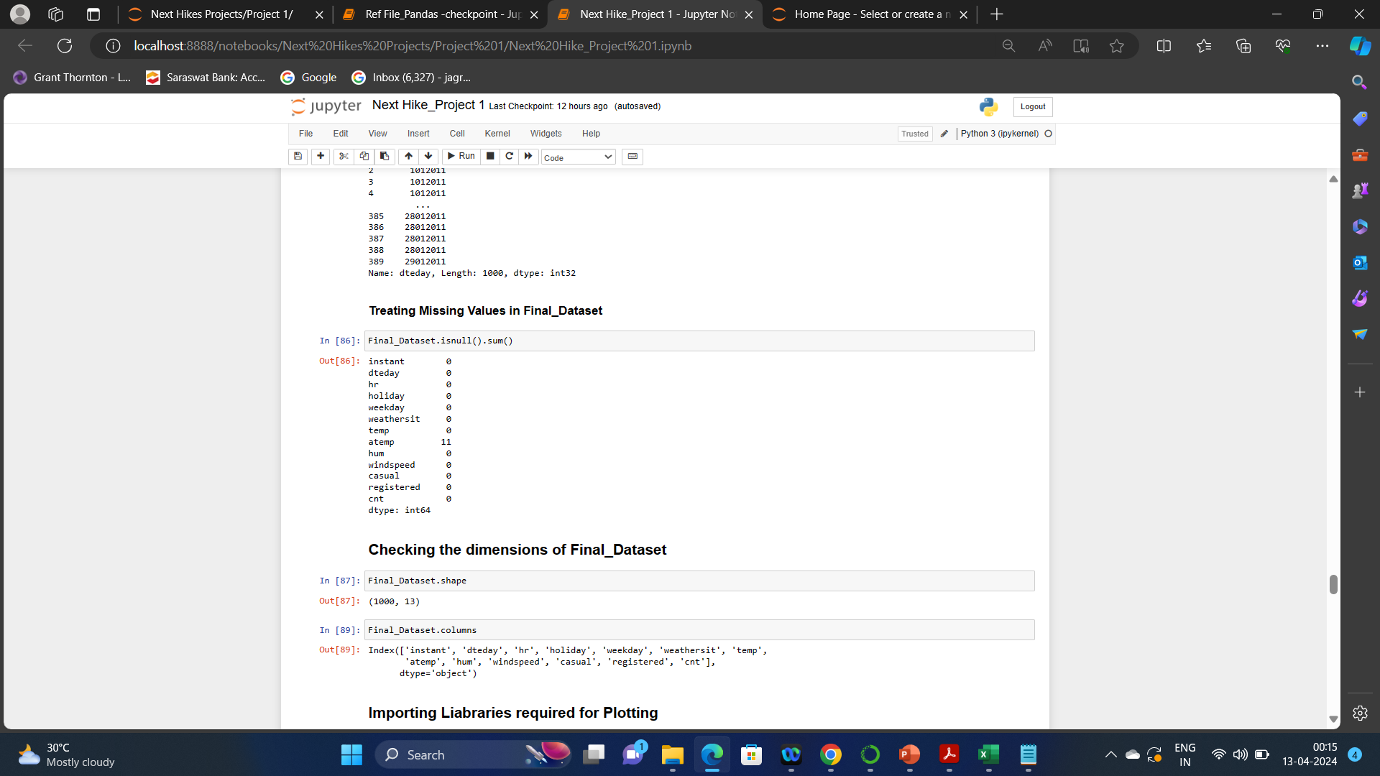
Treating Missing Values: In Python, specifically Pandas, NumPy and Scikit-Learn, we mark missing values as NaN. Values with a NaN value are ignored from operations like sum, count, etc. We can mark values as NaN easily with the Pandas DataFrame by using the replace() function on a subset of the columns we are interested in.
Finding missing values as shown in below screenshots from Task 1 & Task 2

Slide 20
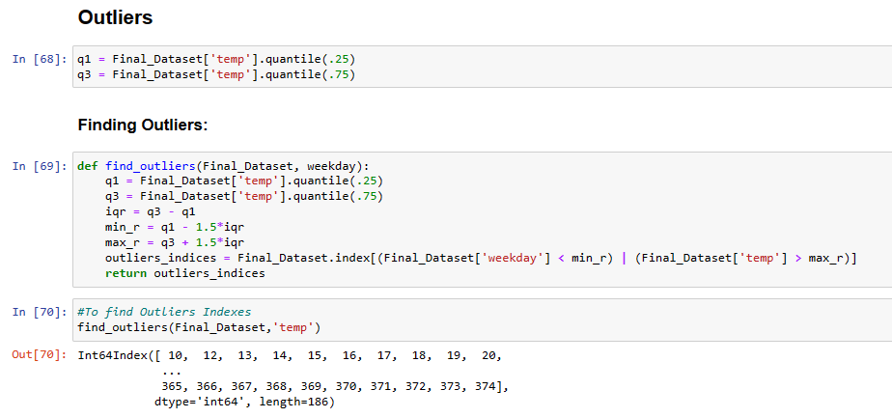
Outliers: Outliers in Python refer to data points that differ significantly from the rest of the data set. They can be identified using a variety of methods, such as the Interquartile Range (IQR) method or the Z-score method. Here are the steps on how to detect outliers in Python using the IQR method:

Slide 21
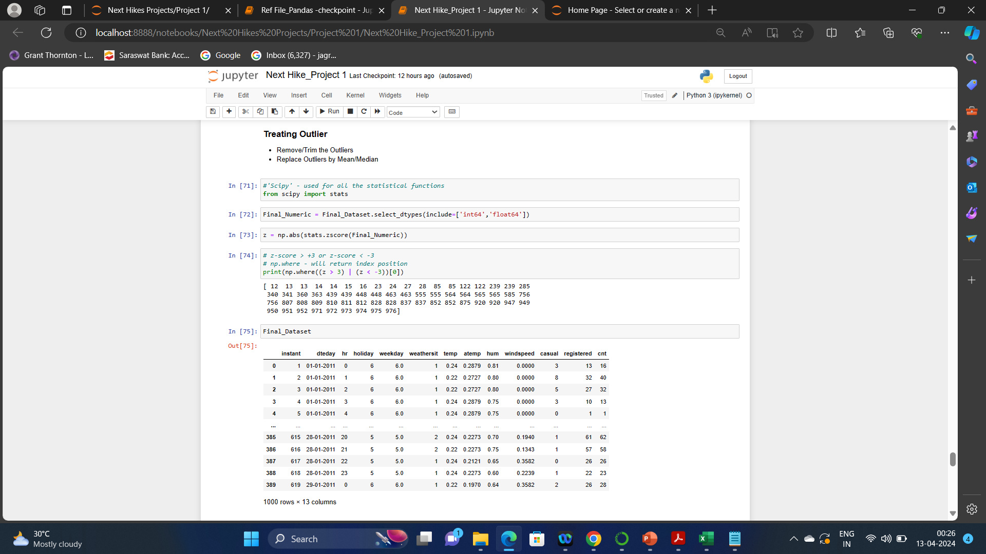
Treating Outliers:

Slide 22
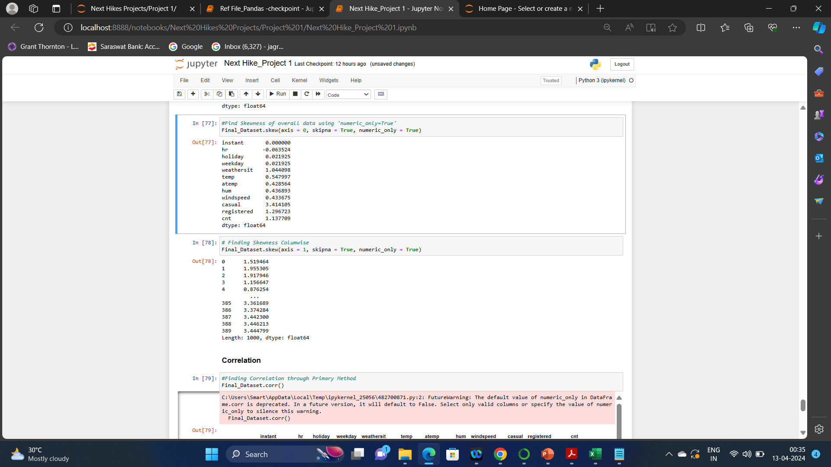
Skewness of data: Skewness is a statistical term and it is a way to estimate or measure the shape of a distribution. It is an important statistical methodology that is used to estimate the asymmetrical behavior rather than computing frequency distribution.
Screenshots of finding skewness is shown below:

Slide 23
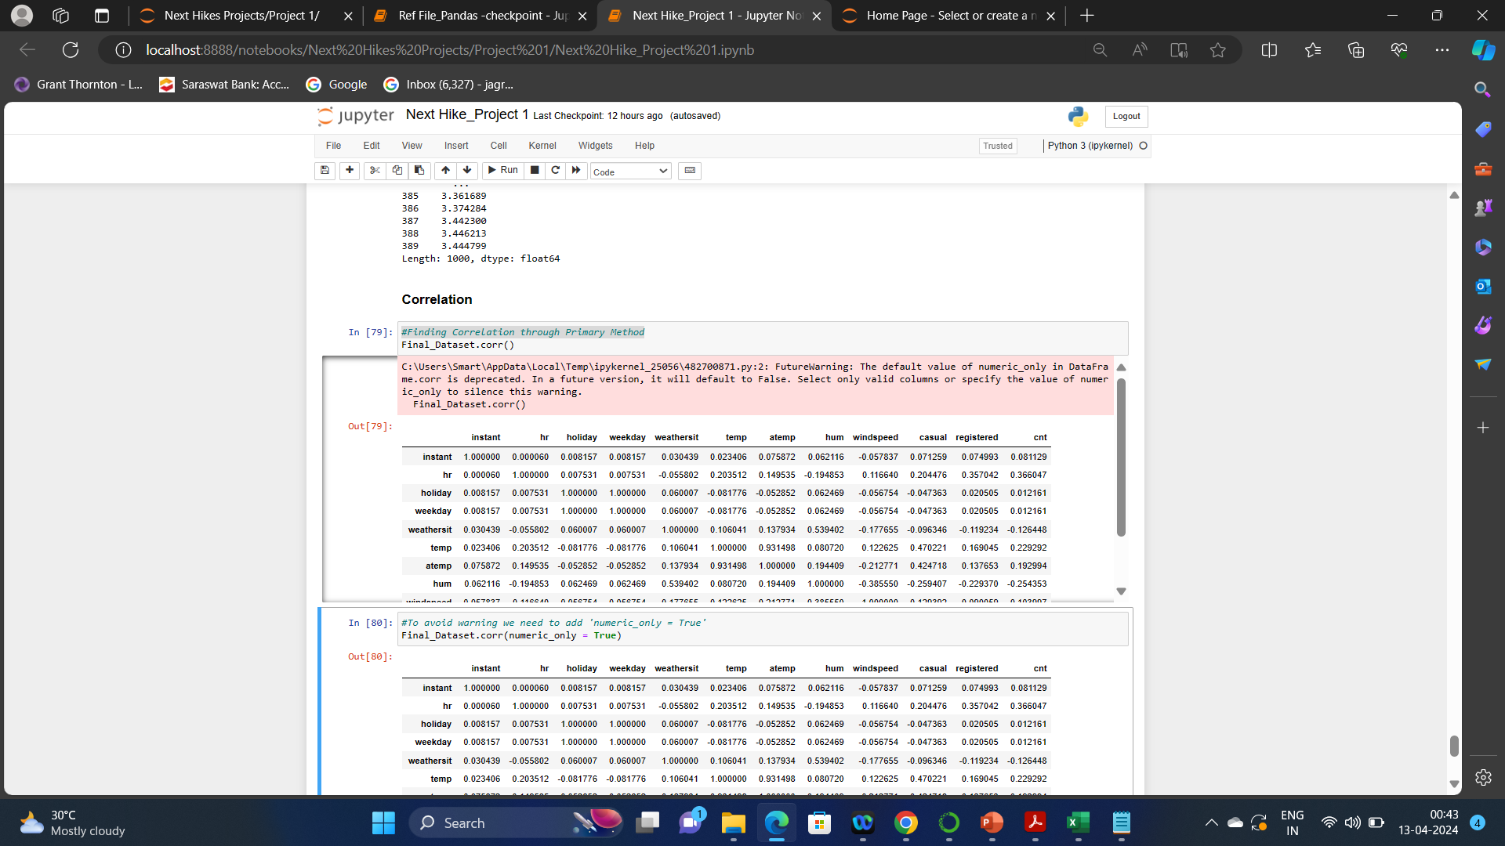
Correlation of data corr(): Correlation is defined as the association between two random variables. In statistics it normally refers to the degree a pair of variables are linearly related. ‘.corr()’ is used to find the pairwise correlation of all columns in the Pandas Data frame in Python.
Screenshots for calculation of correlation of data is shown below:

Slide 24
Note for the checker of the Project: All the screenshots attached in the PPT are taken from the Jupyter notebook of Project 1 in which all the Tasks are performed. Serial nos. of commands in screenshots may differ from the serial nos. in the Jupyter notebook because few more commands were performed after the completion of PPT.
Thank You

